Slide 1

Web Technology (16ITC19) UNIT - II

Slide 2
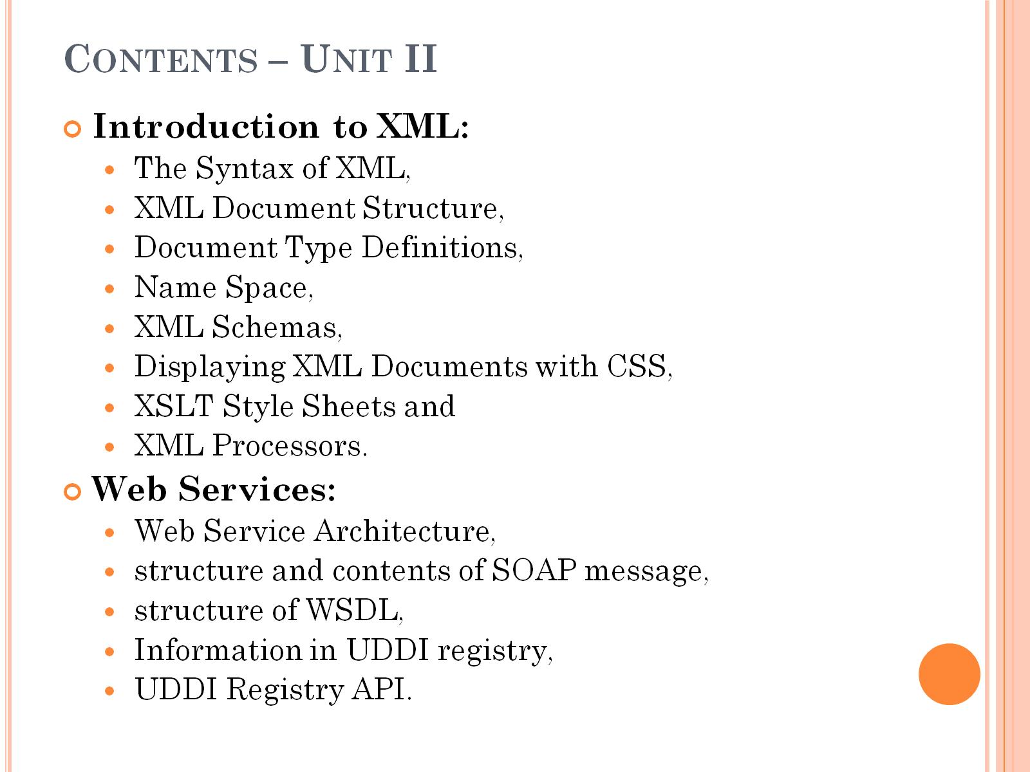
Contents – Unit II

Slide 3
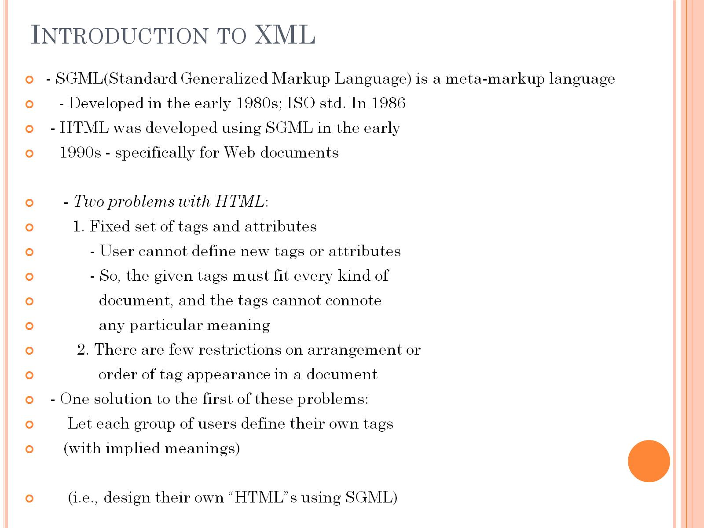
Introduction to XML

Slide 4
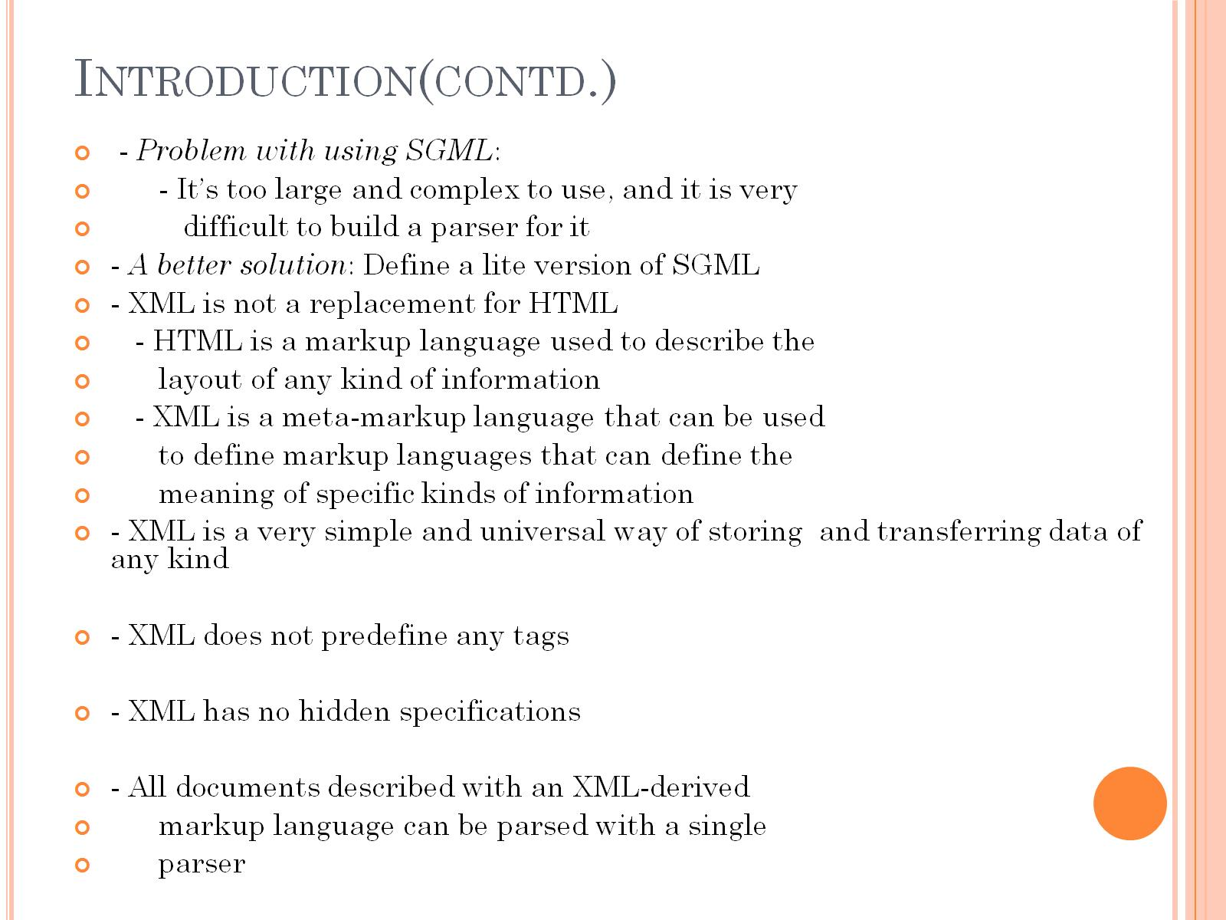
Introduction(contd.)

Slide 5
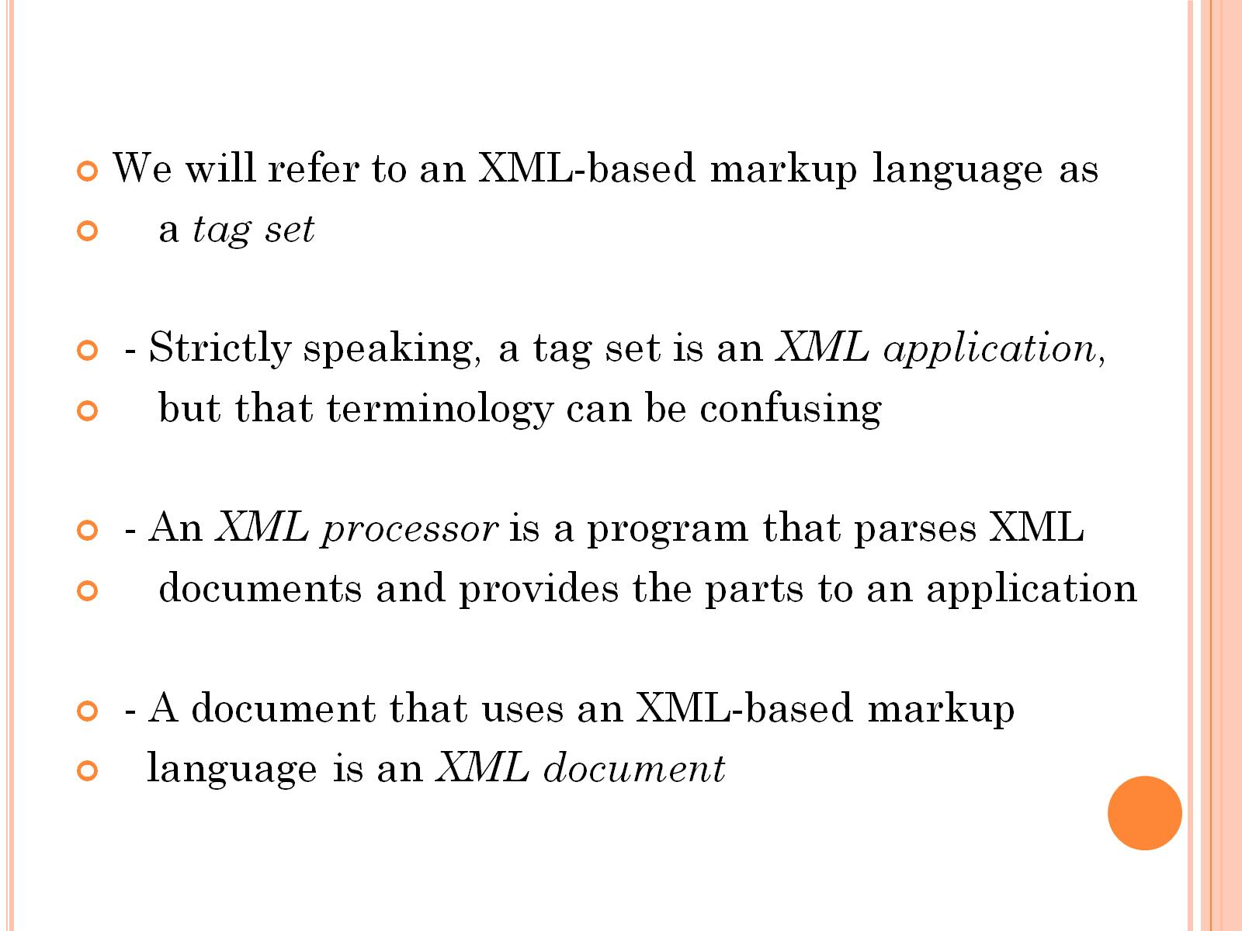

Slide 6
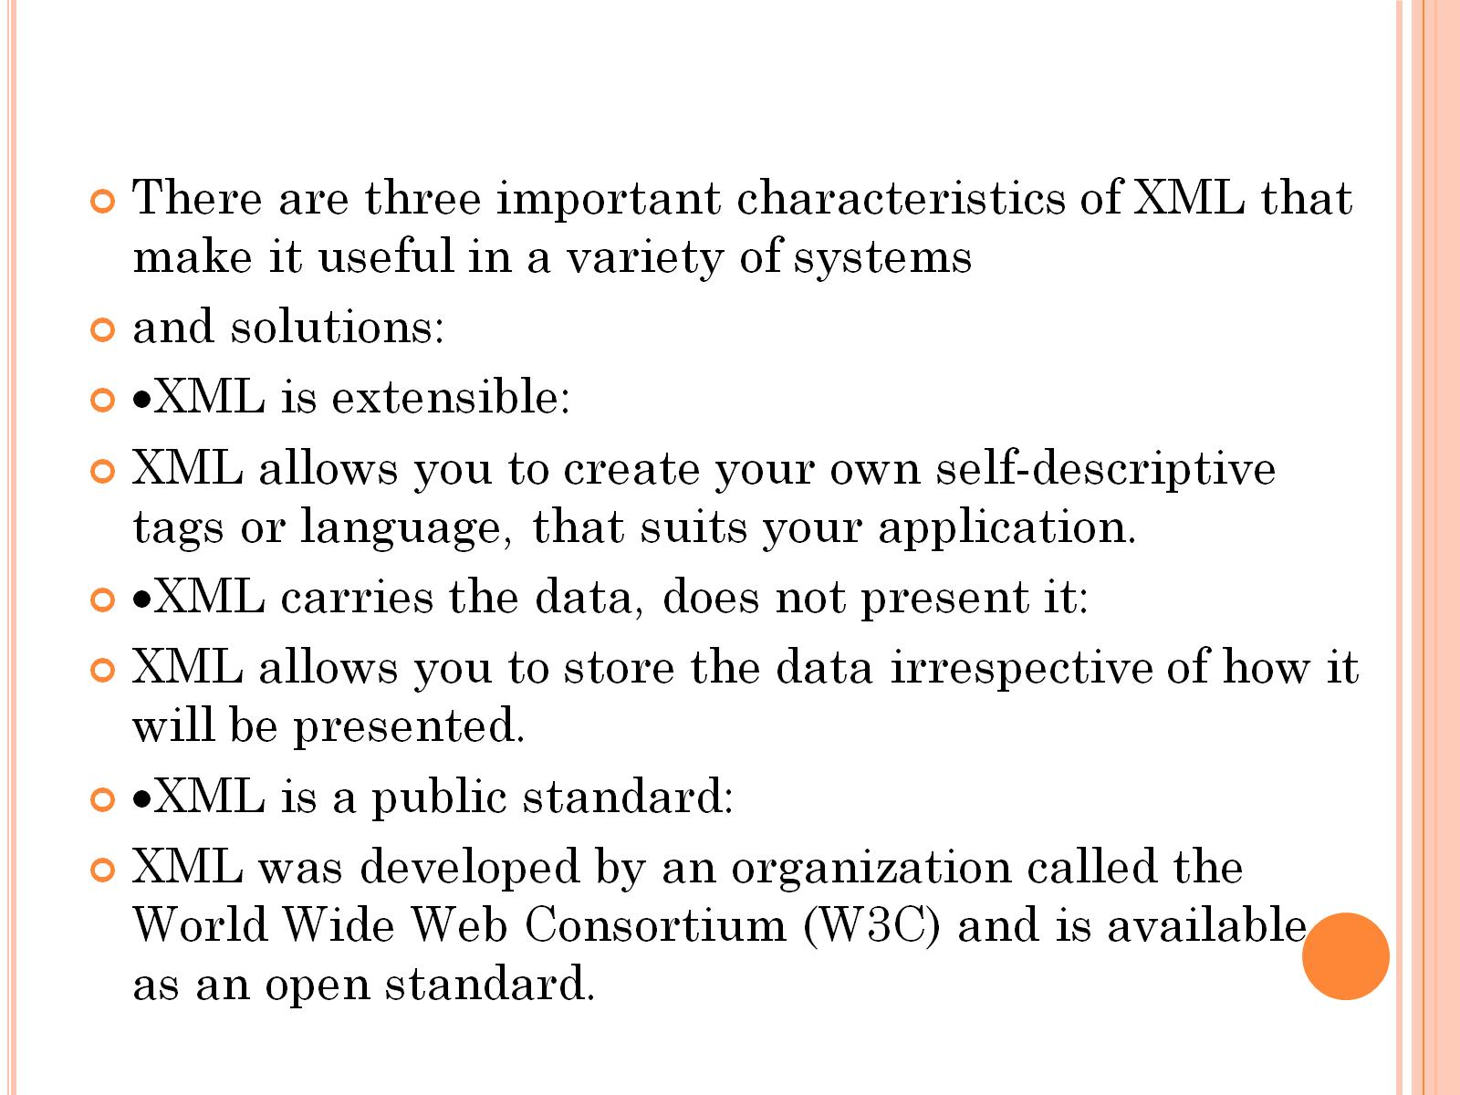

Slide 7
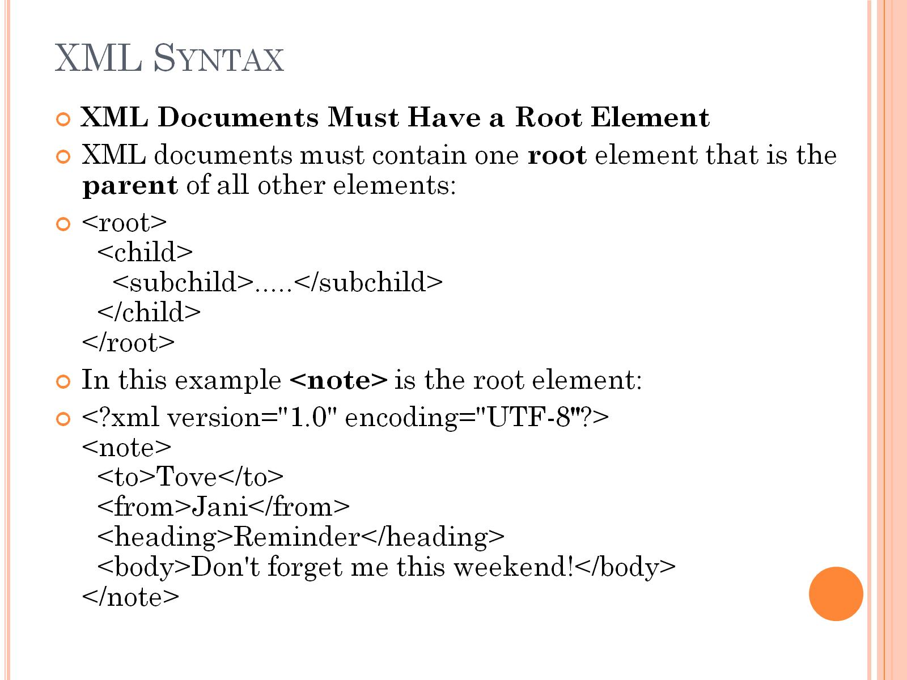
XML Syntax

Slide 8
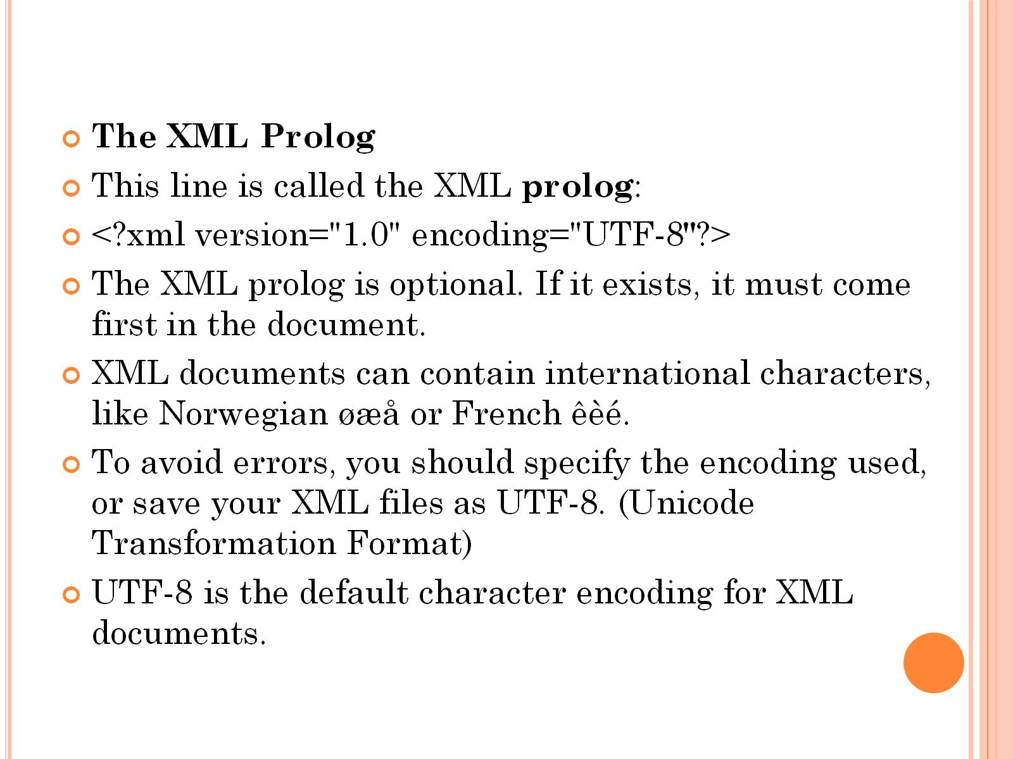

Slide 9
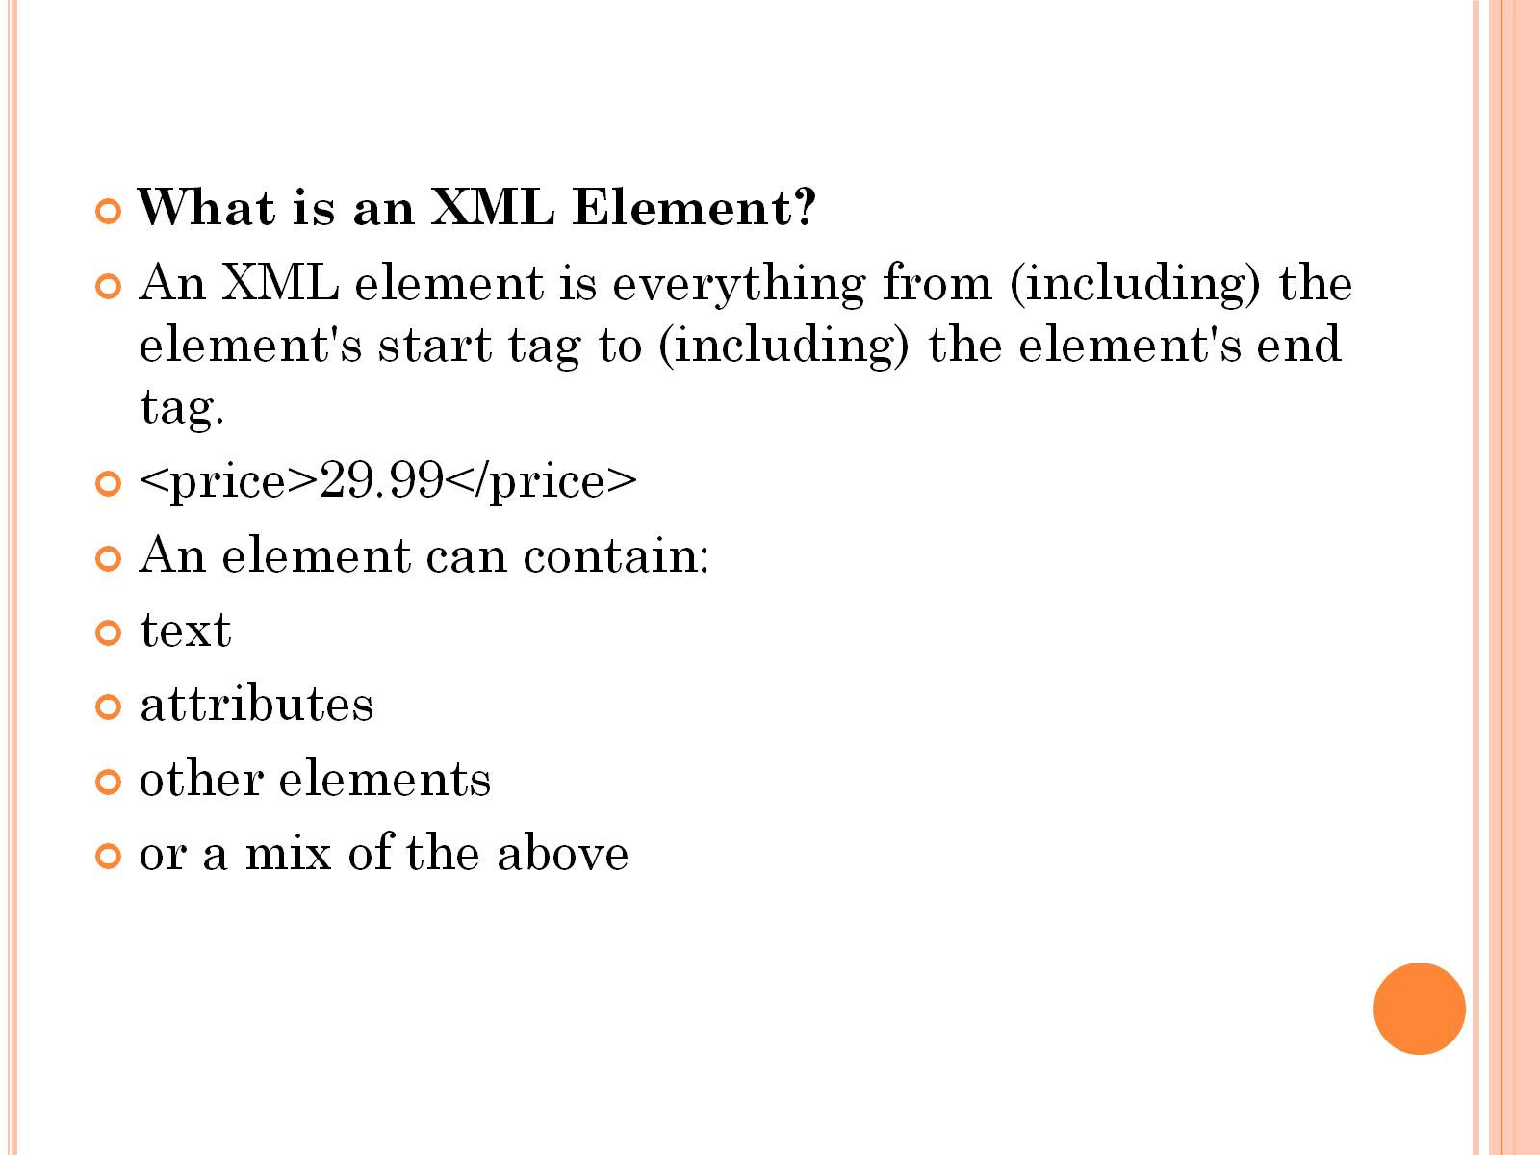

Slide 10
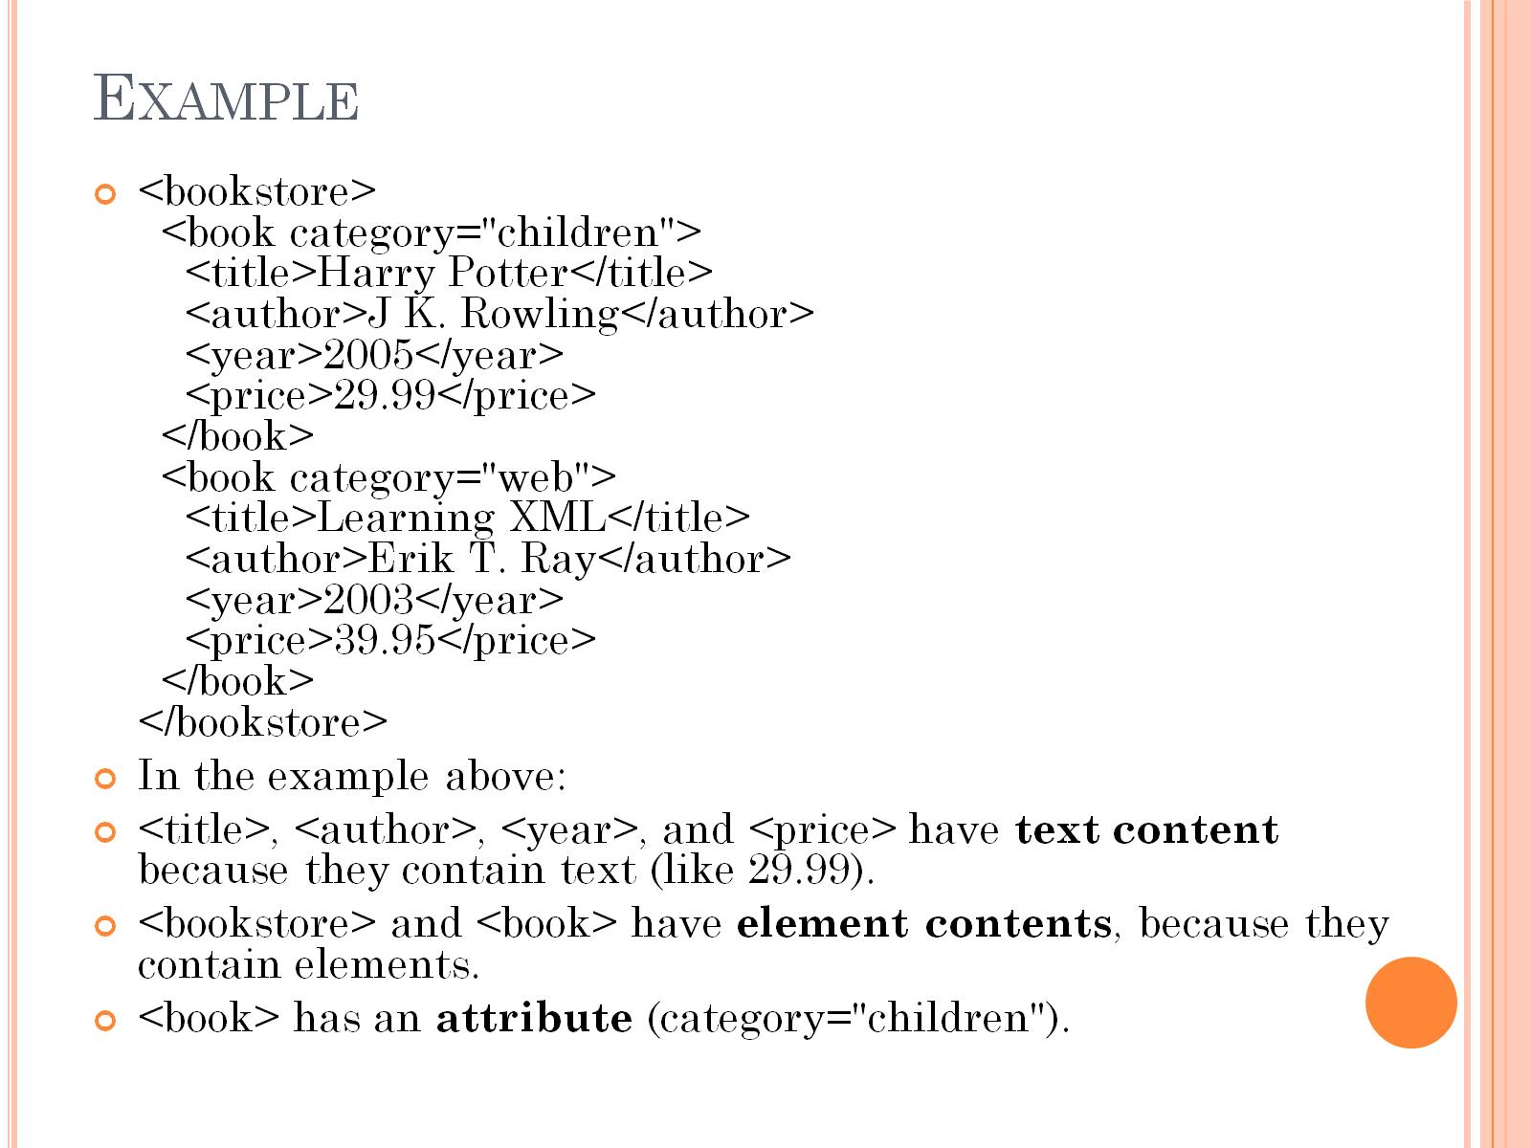
Example

Slide 11
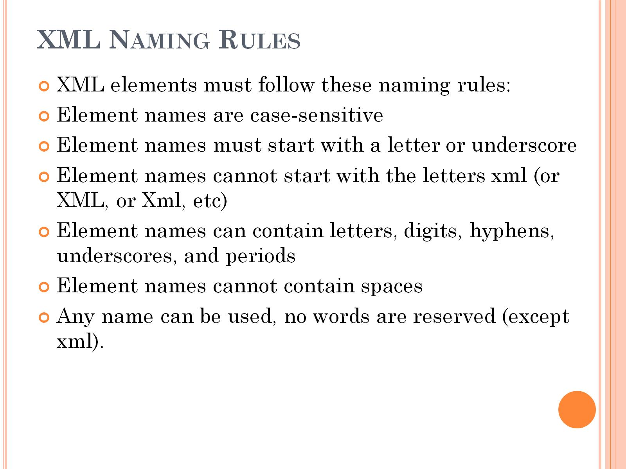
XML Naming Rules

Slide 12
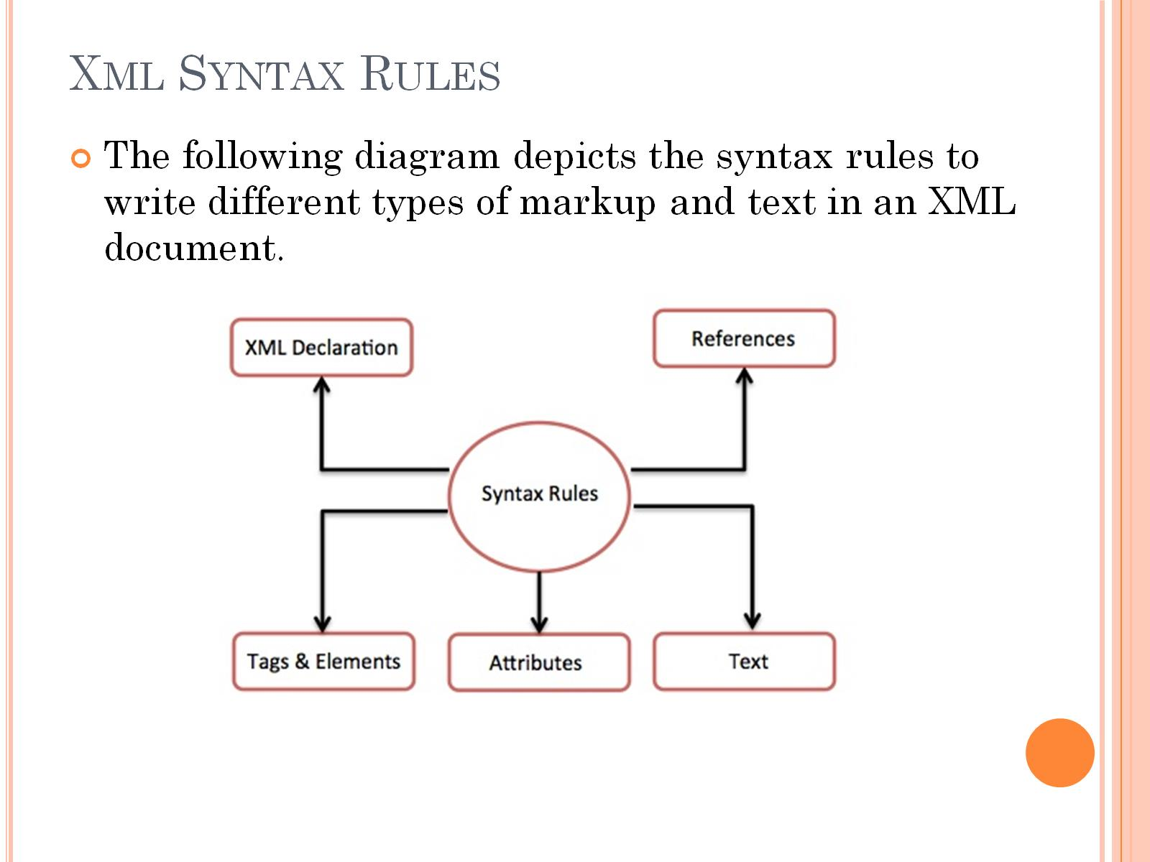
Xml Syntax Rules

Slide 13
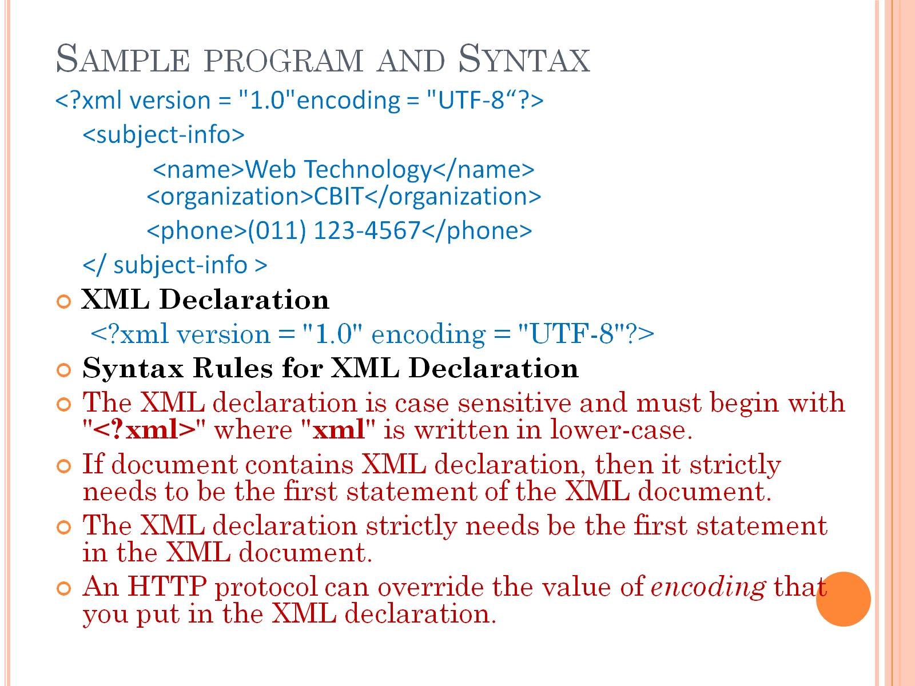
Sample program and Syntax

Slide 14
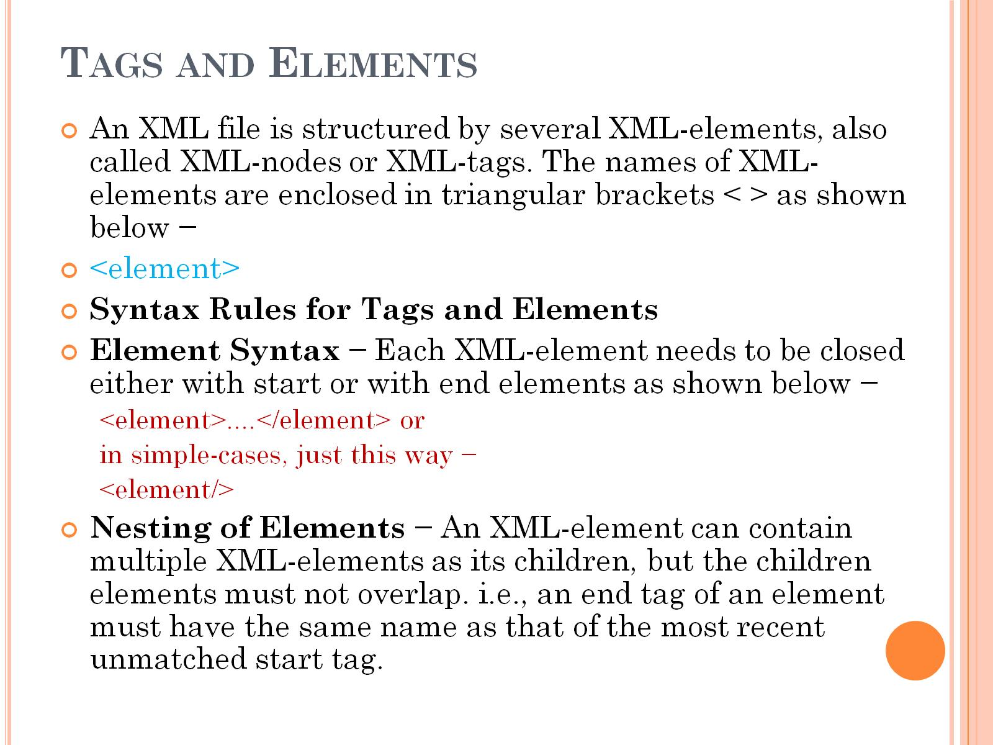
Tags and Elements

Slide 15
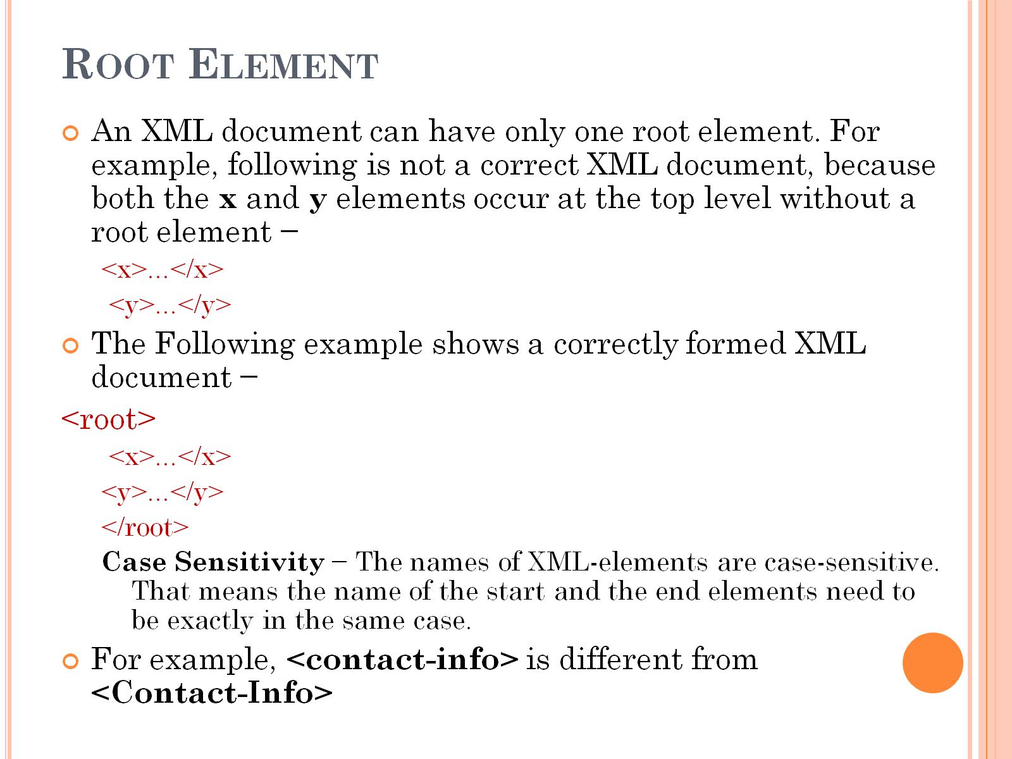
Root Element

Slide 16
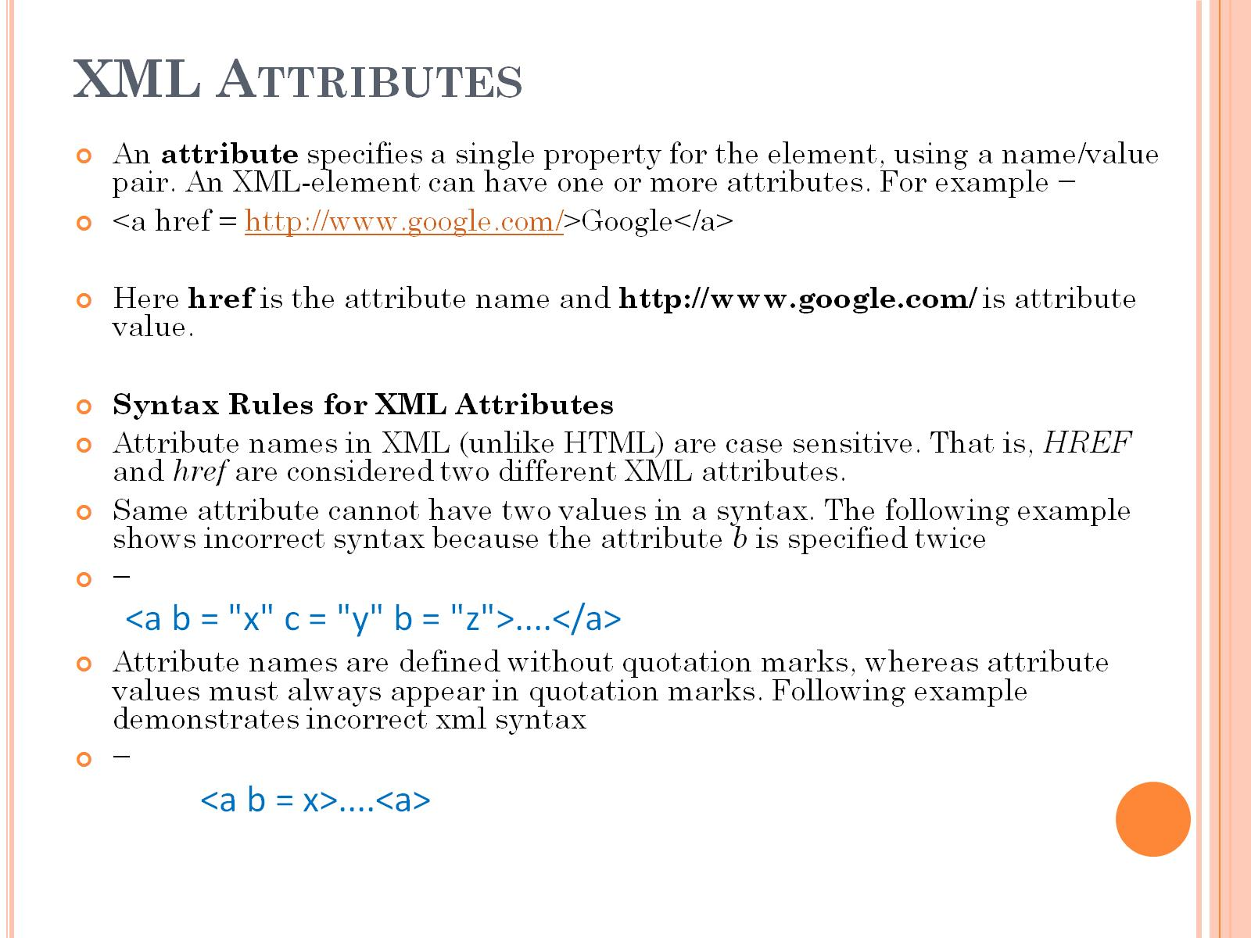
XML Attributes

Slide 17
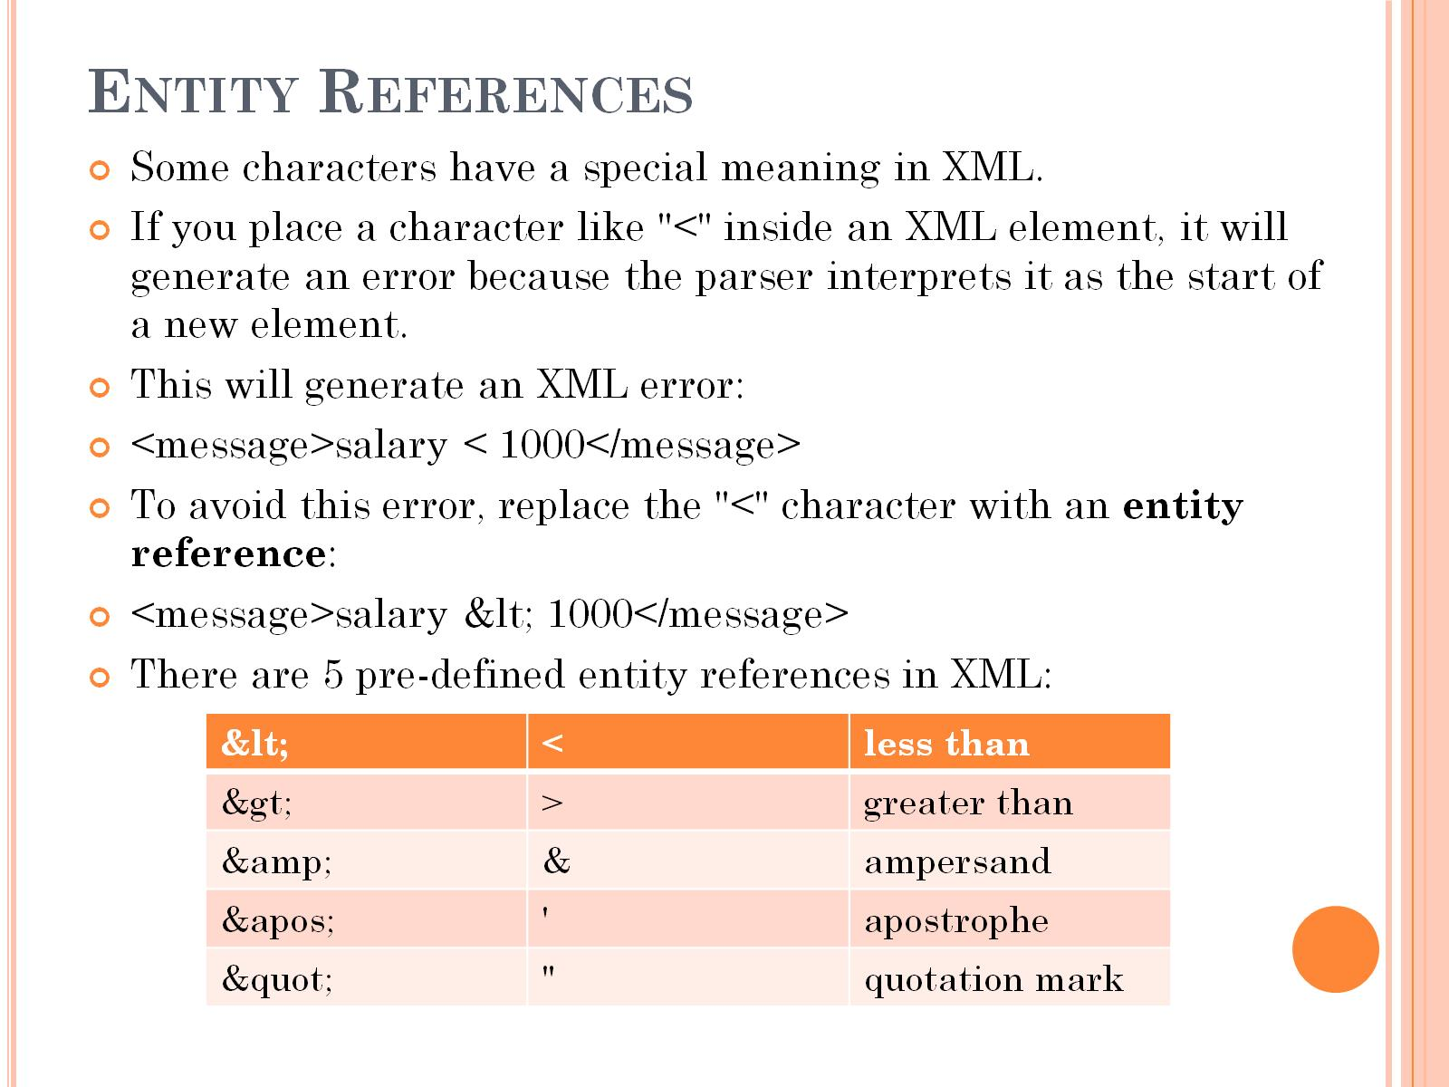
Entity References

Slide 18
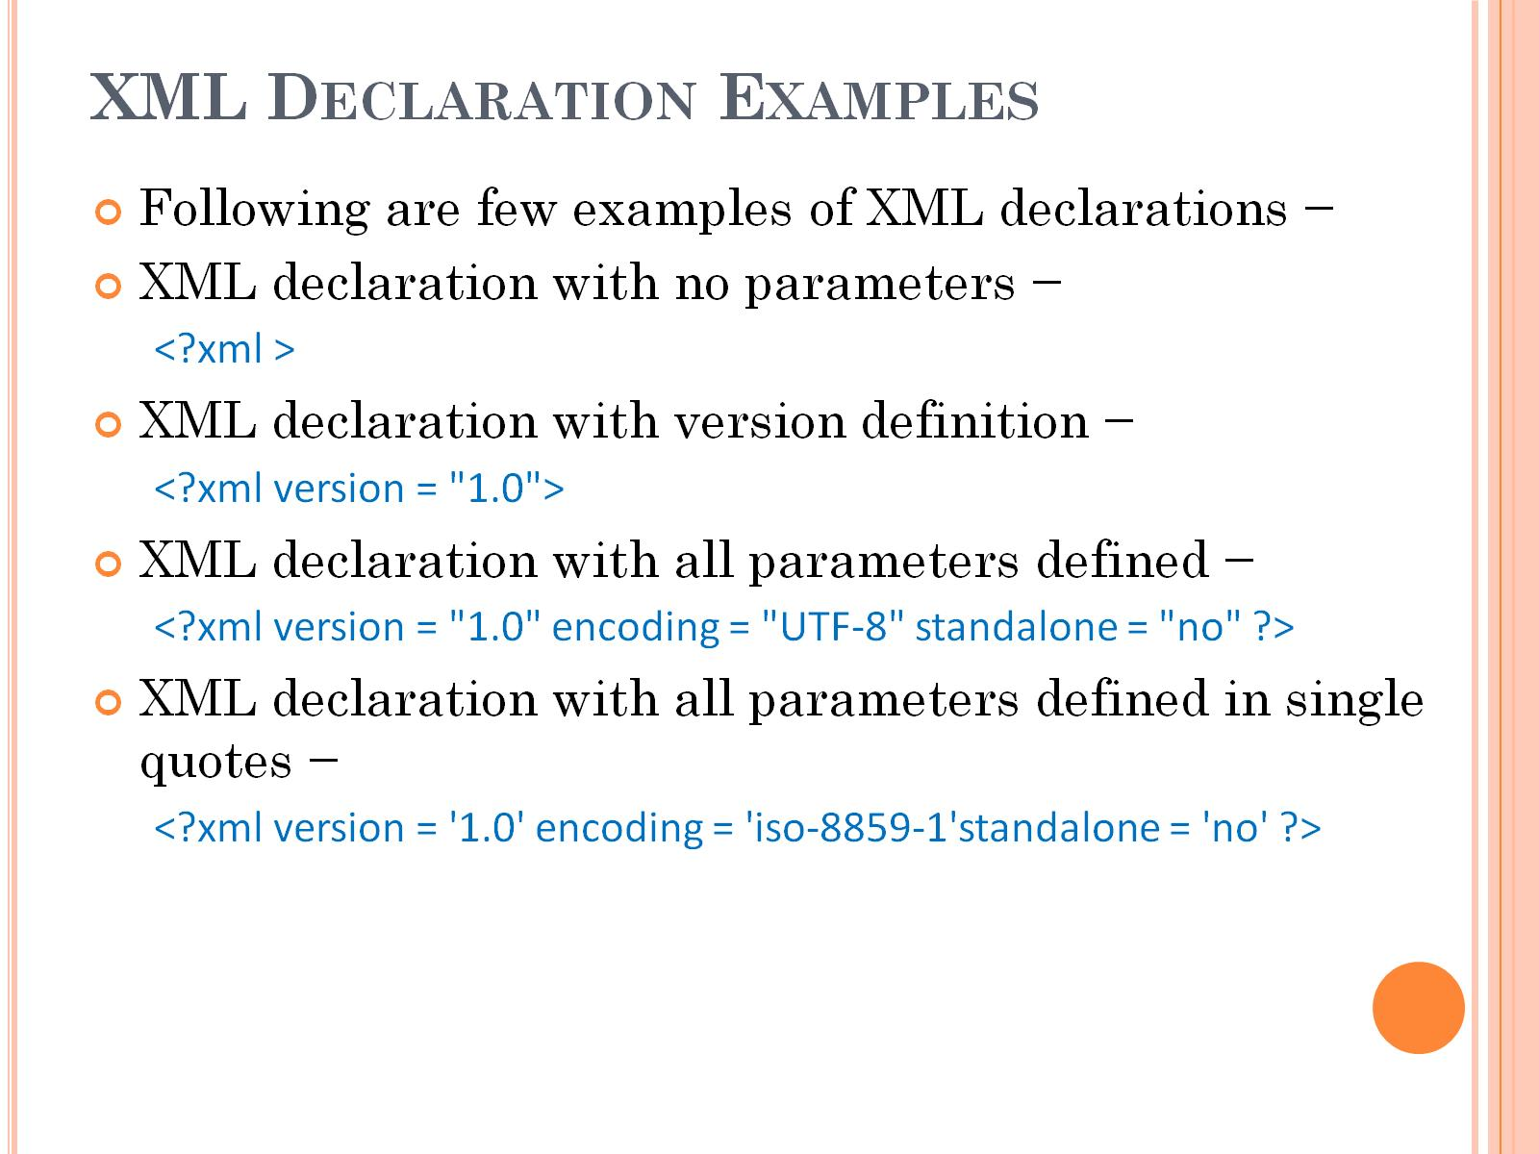
XML Declaration Examples

Slide 19
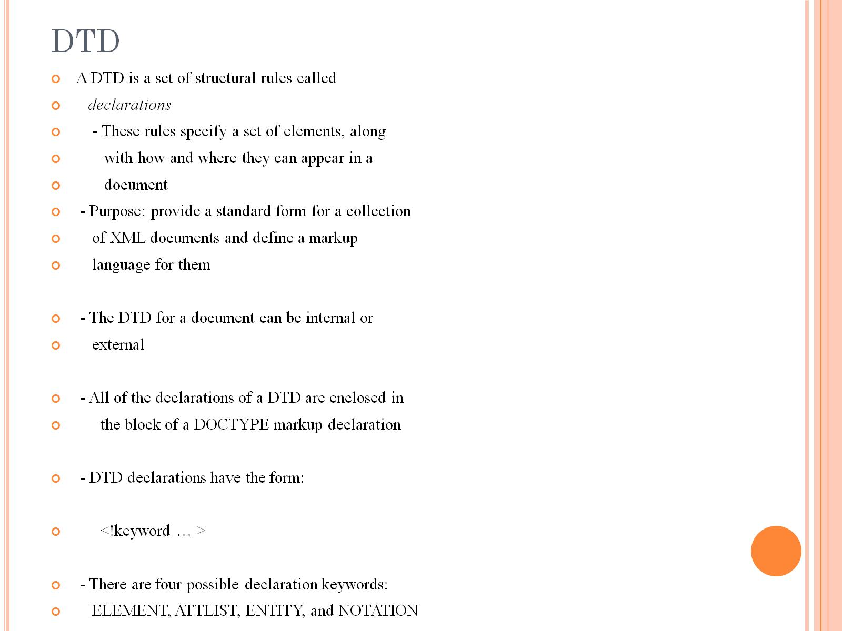
DTD

Slide 20
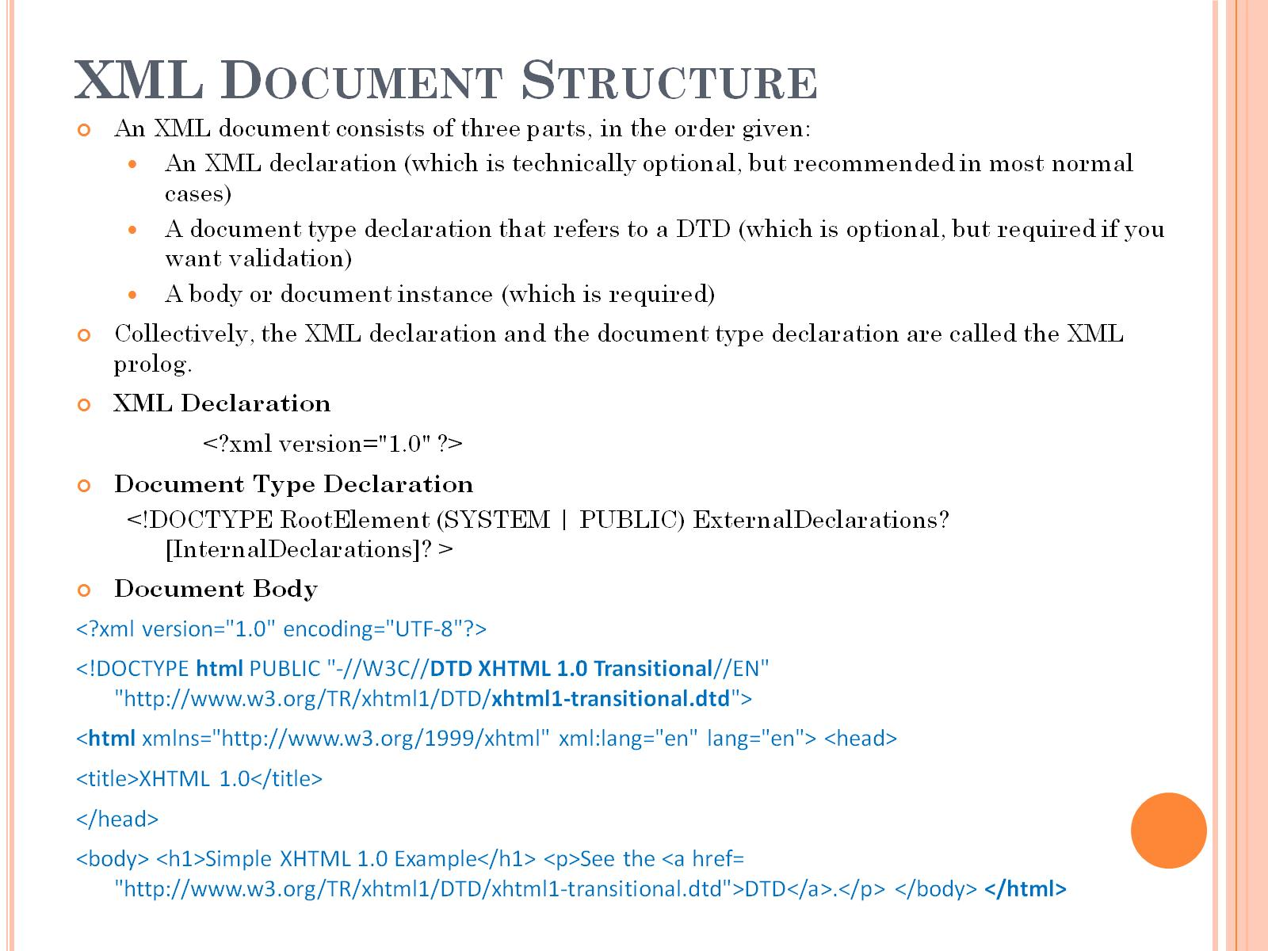
XML Document Structure

Slide 21
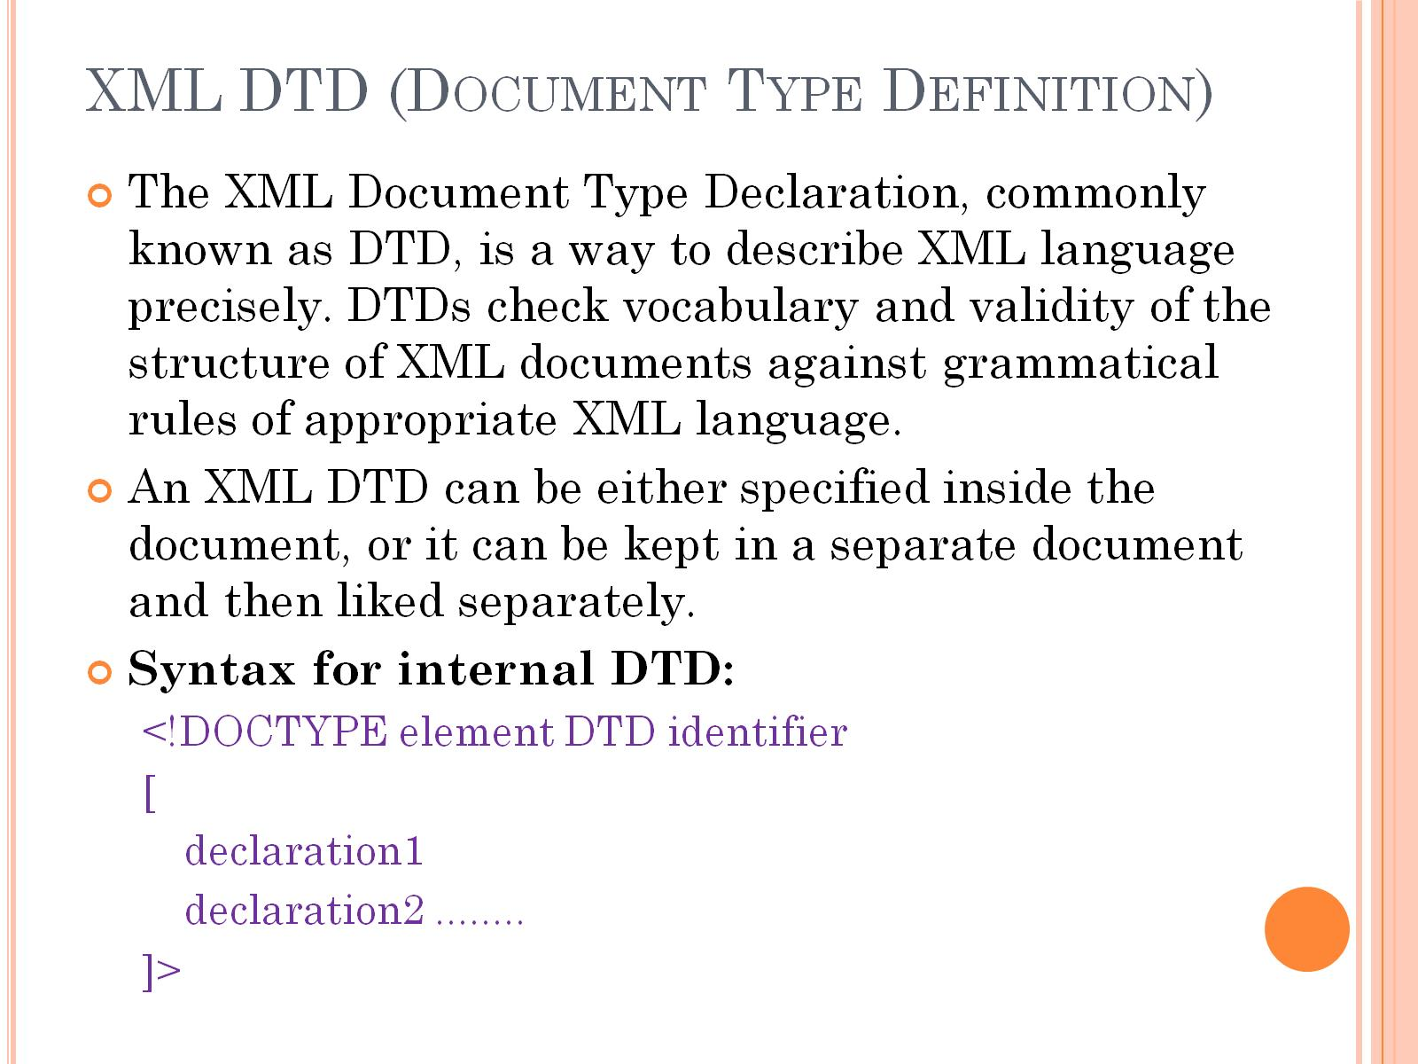
XML DTD (Document Type Definition)

Slide 22
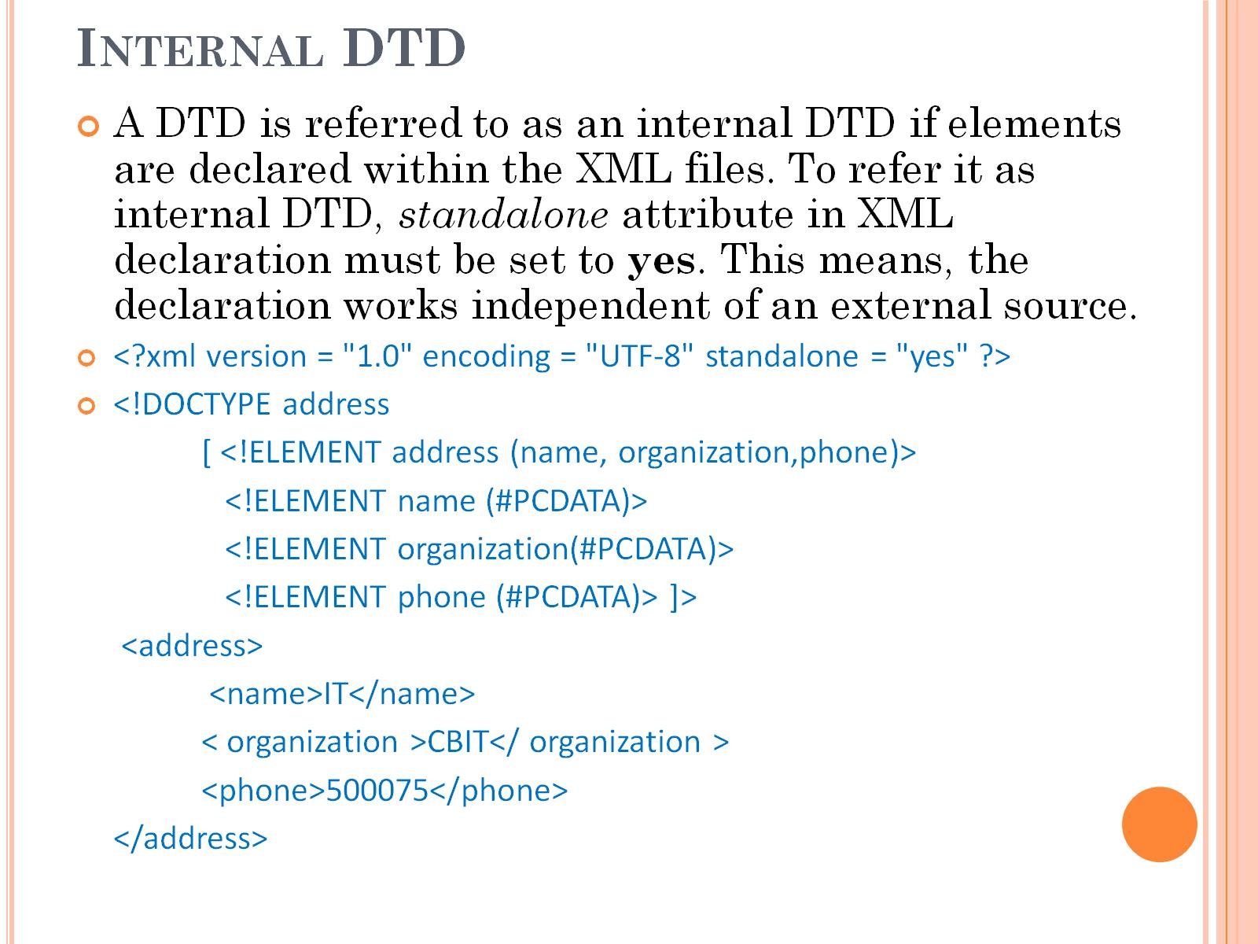
Internal DTD

Slide 23
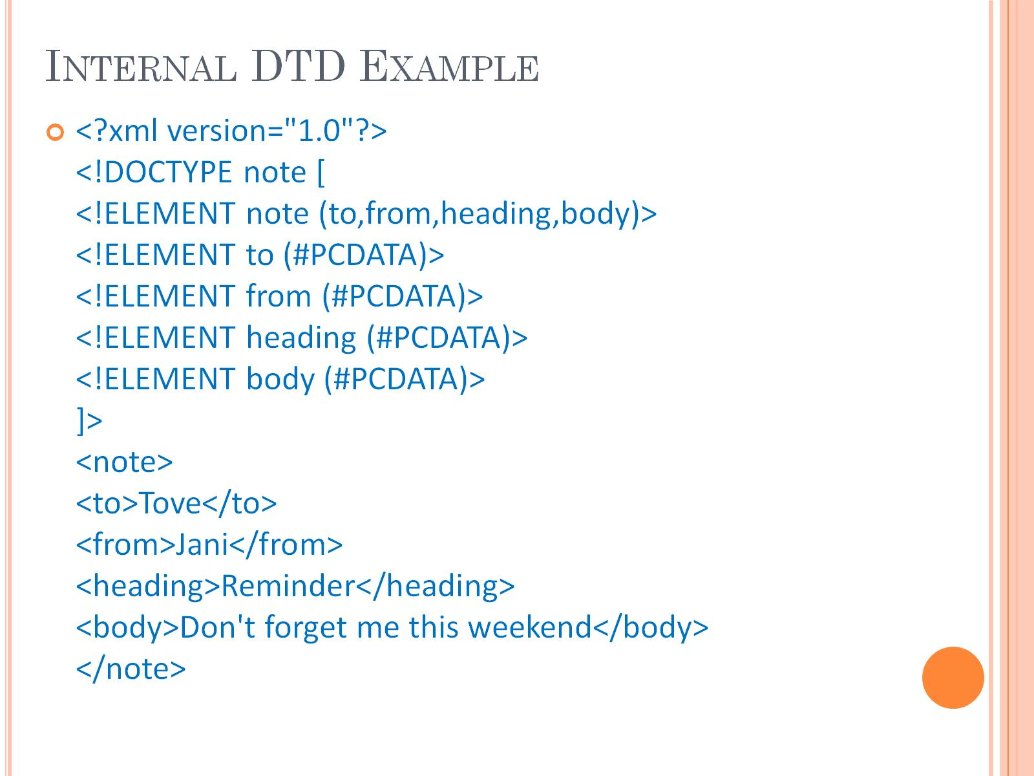
Internal DTD Example

Slide 24
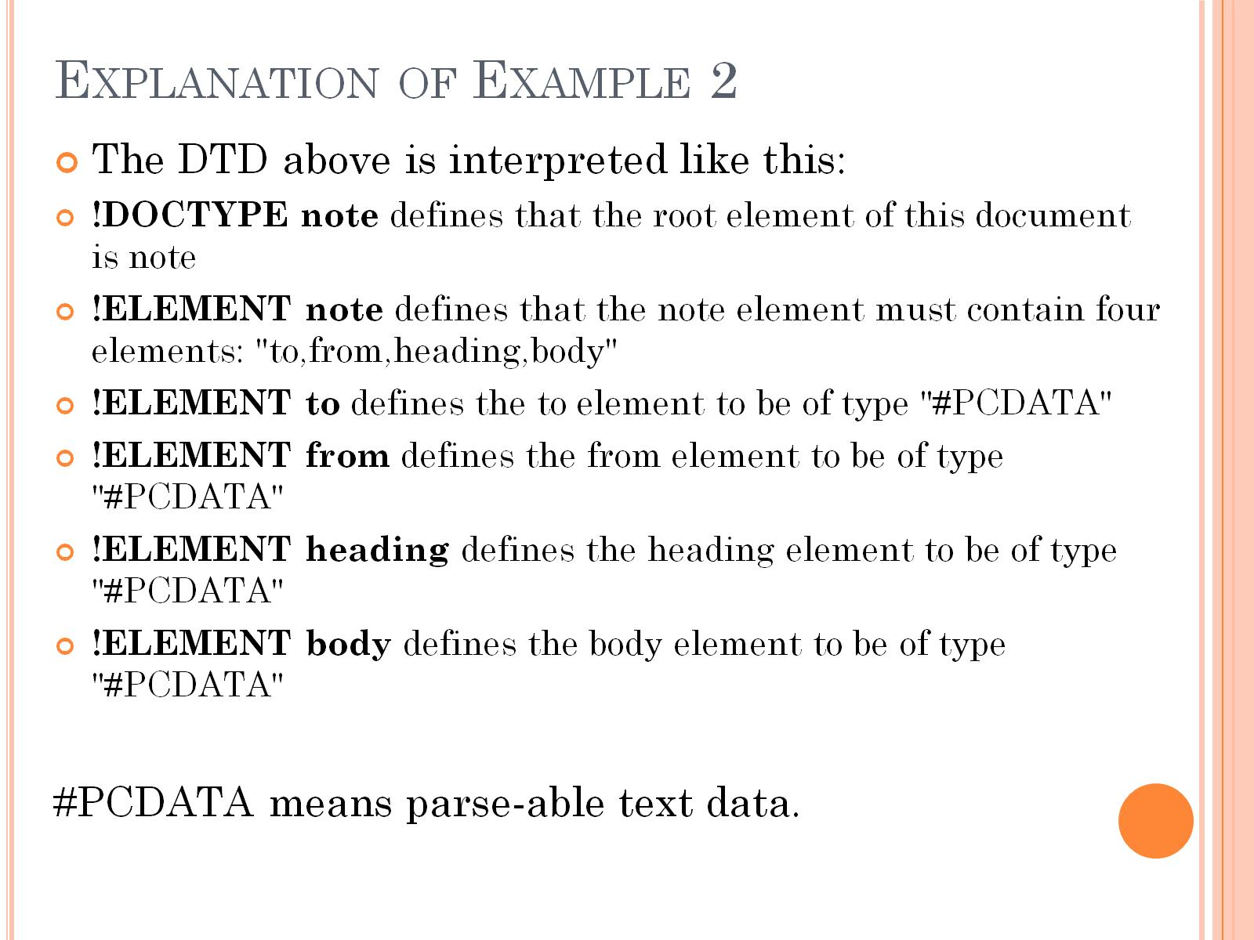
Explanation of Example 2

Slide 25
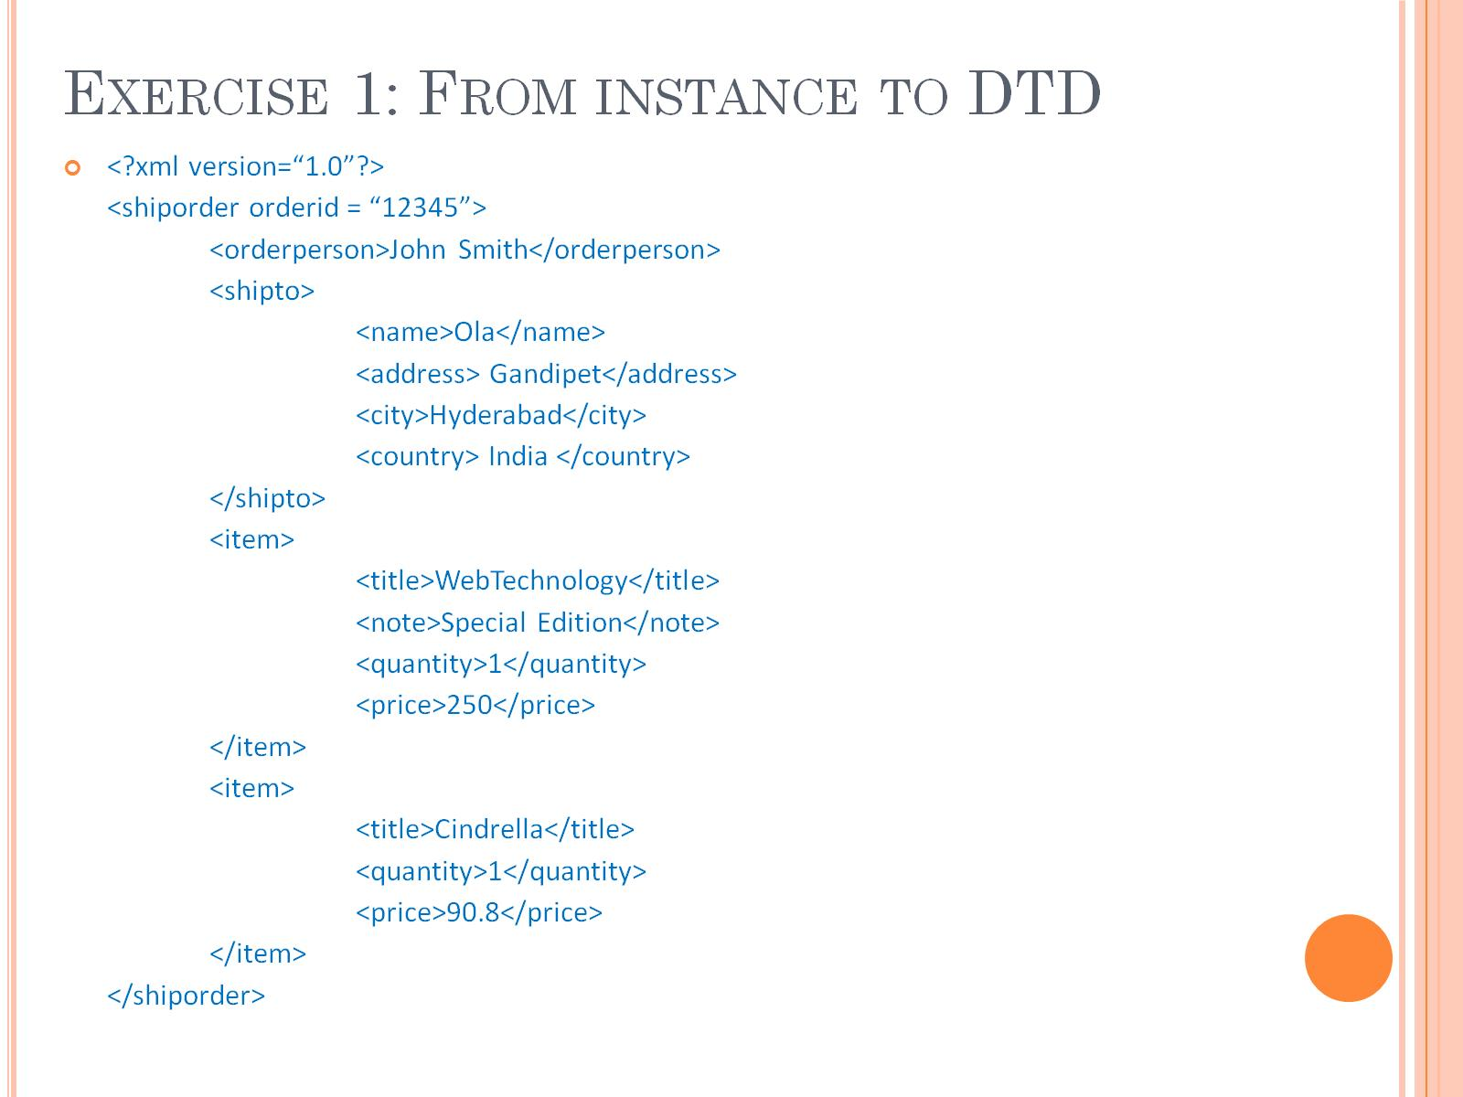
Exercise 1: From instance to DTD

Slide 26
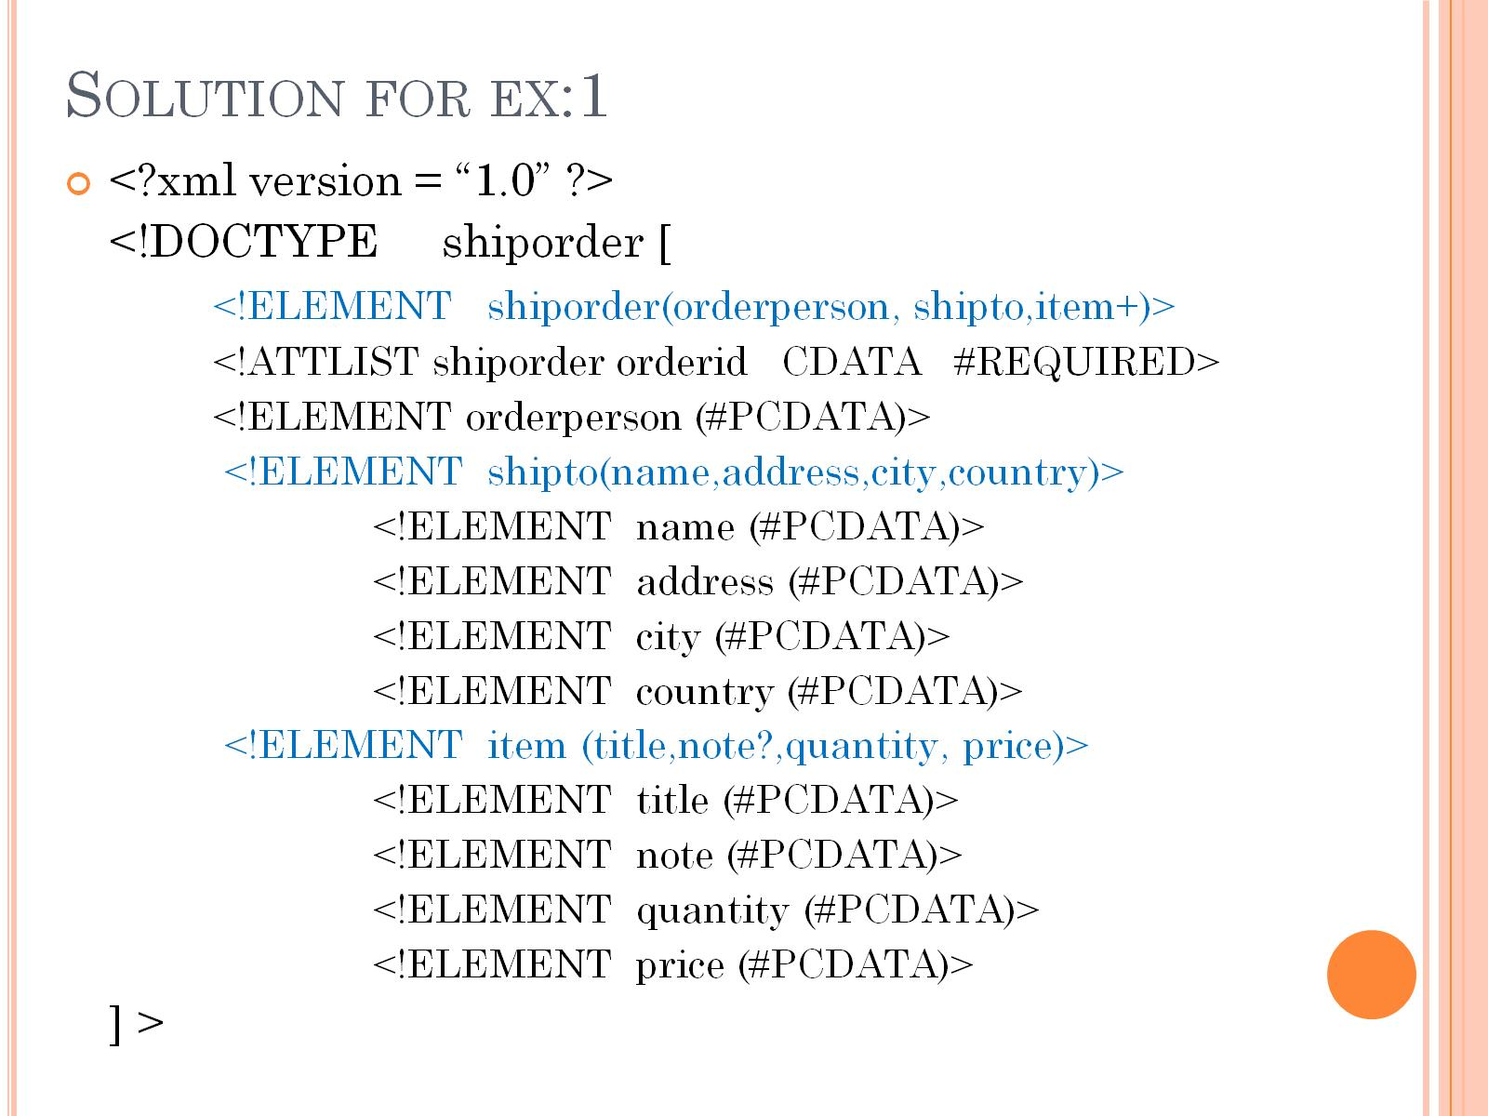
Solution for ex:1

Slide 27
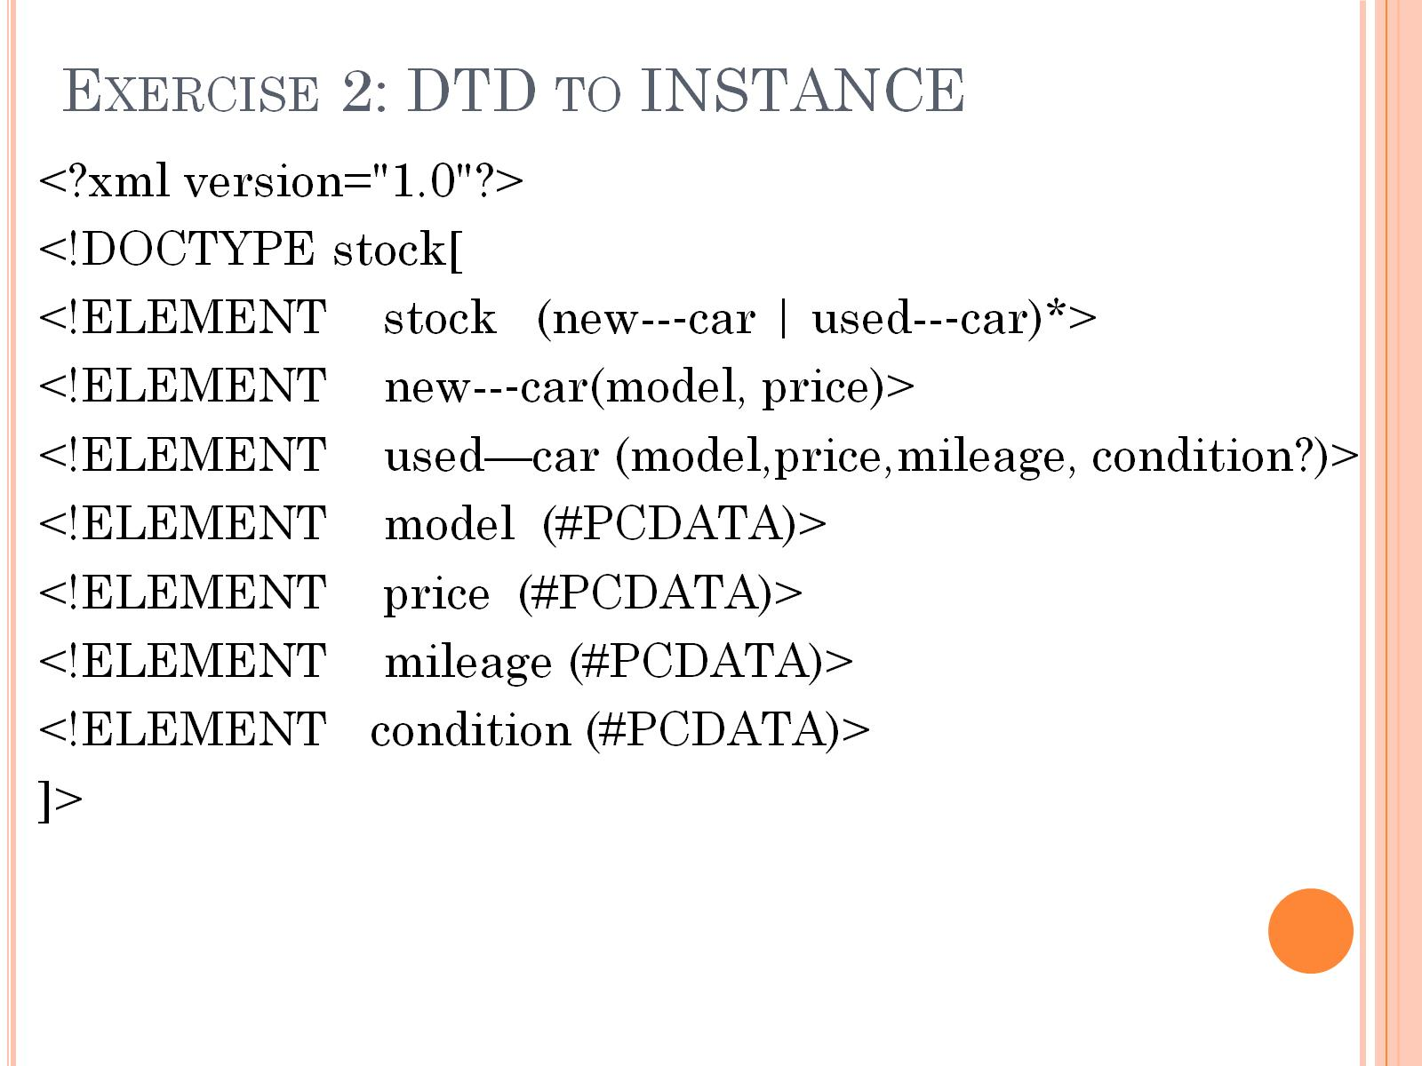
Exercise 2: DTD to INSTANCE

Slide 28
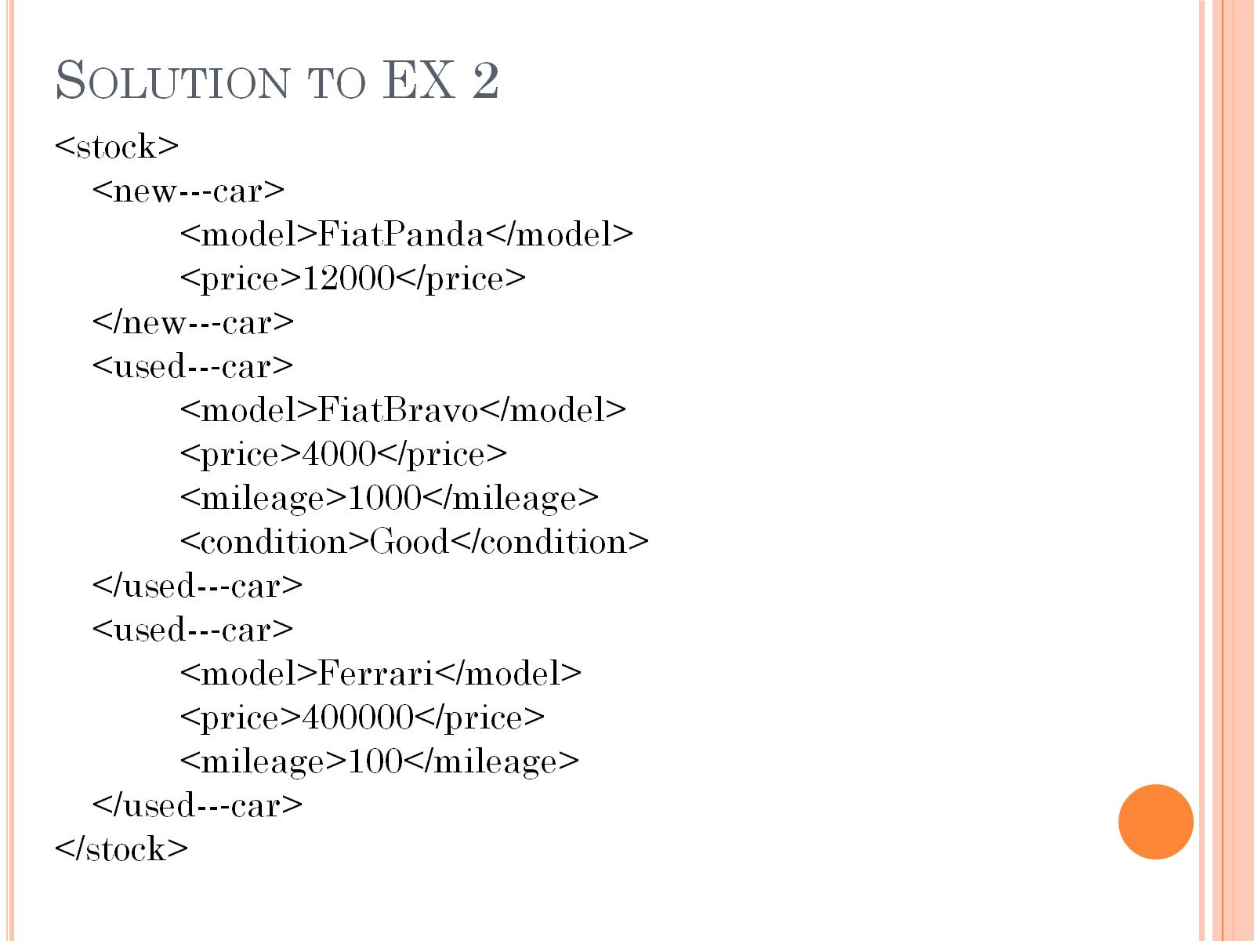
Solution to EX 2

Slide 29
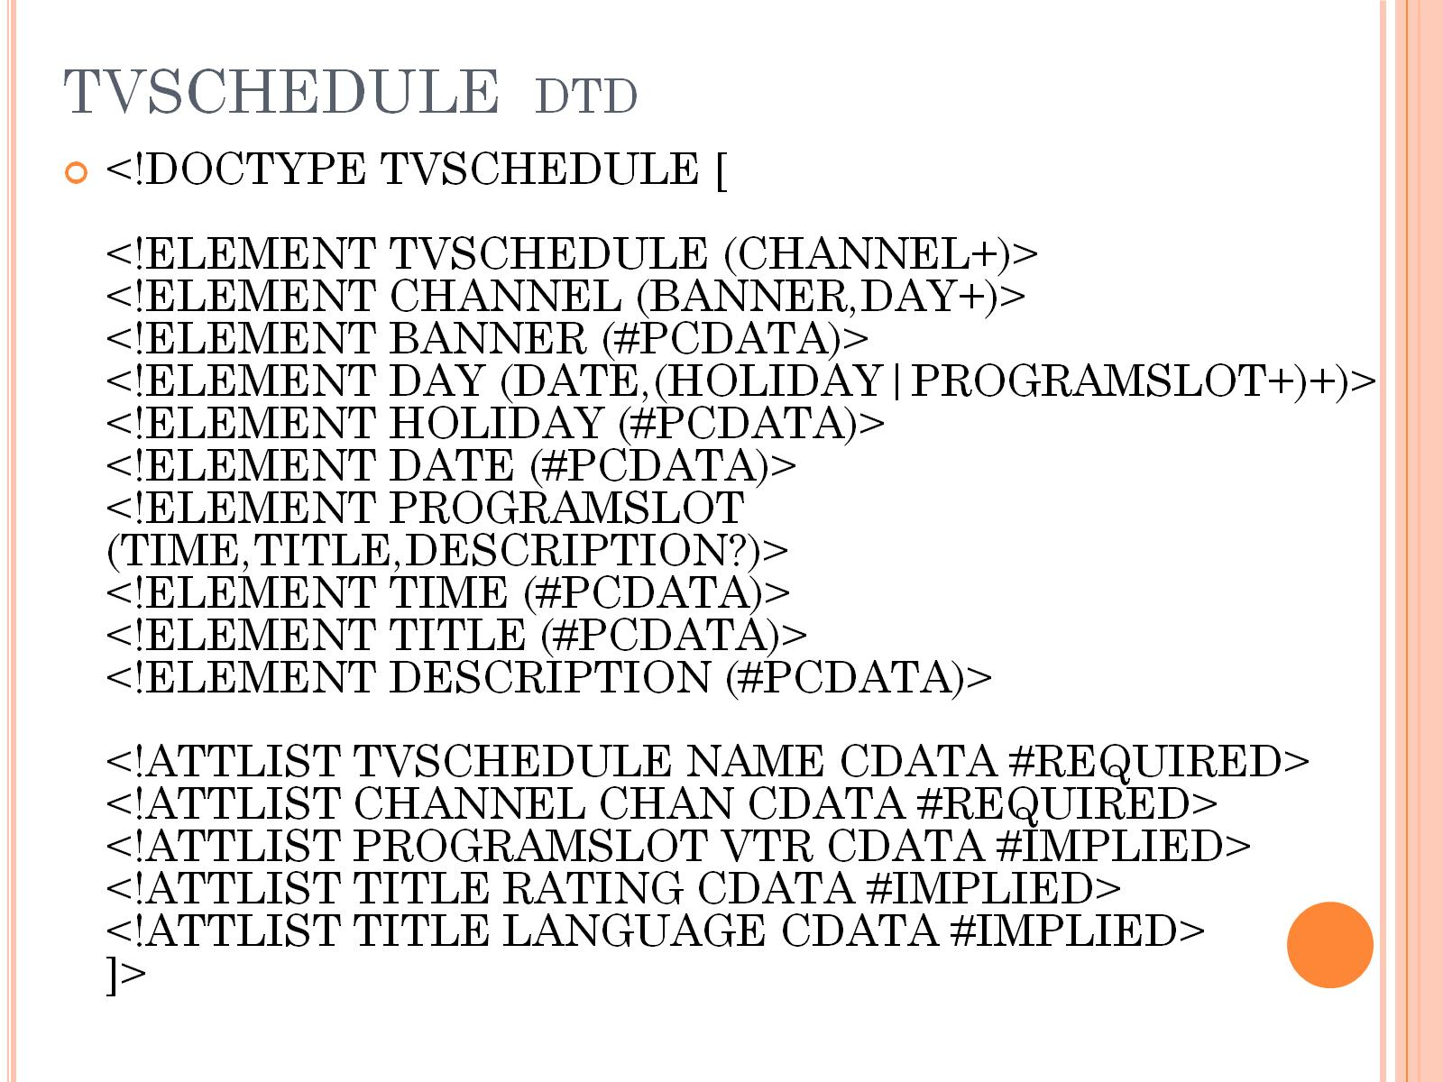
TVSCHEDULE dtd

Slide 30
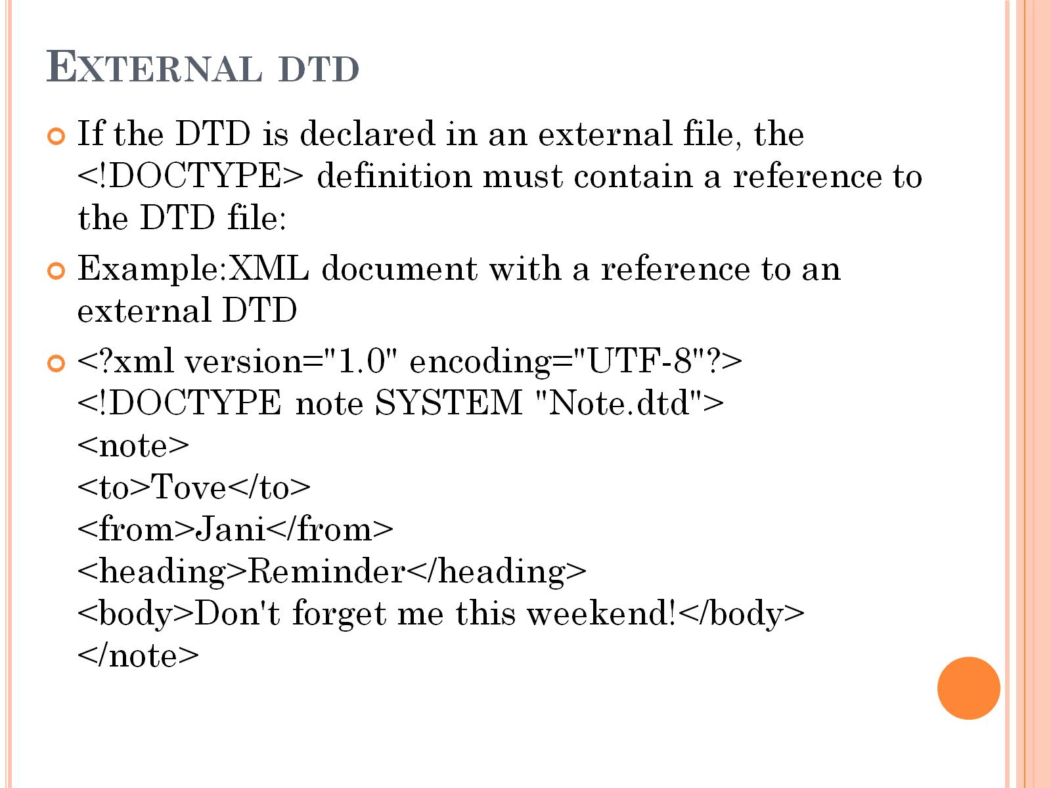
External dtd

Slide 31
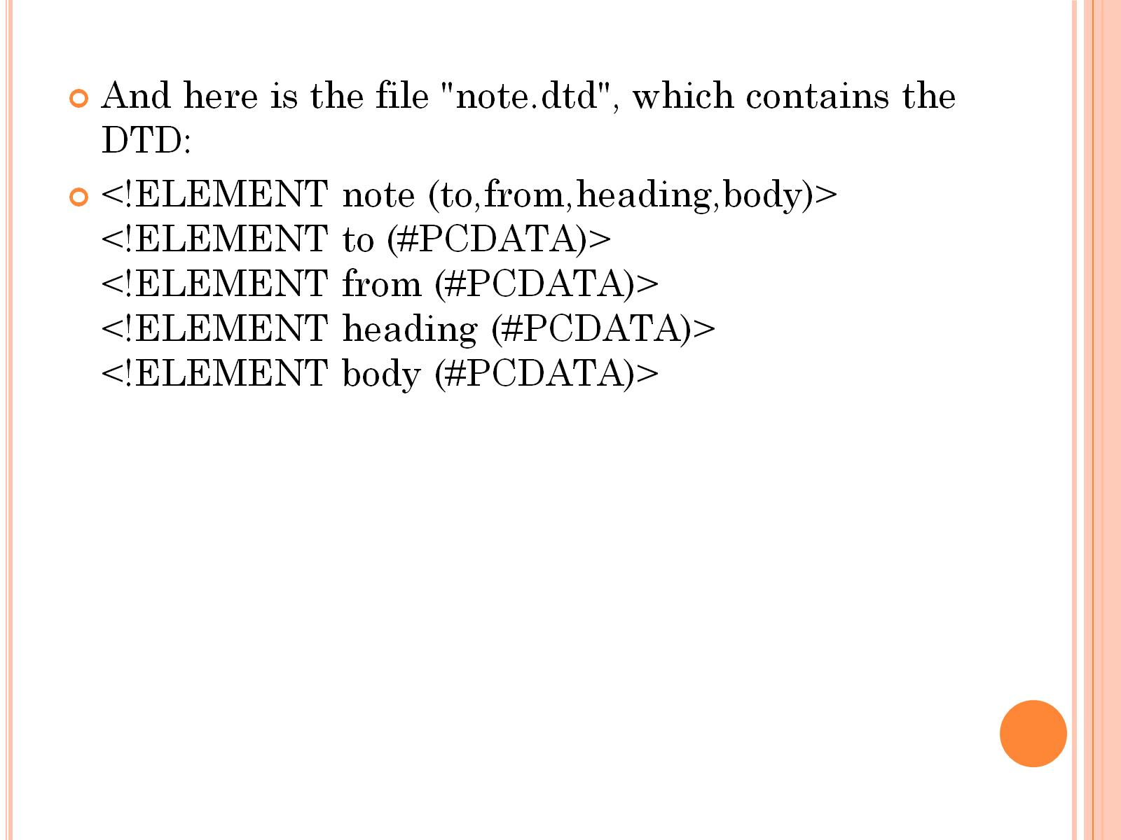

Slide 32
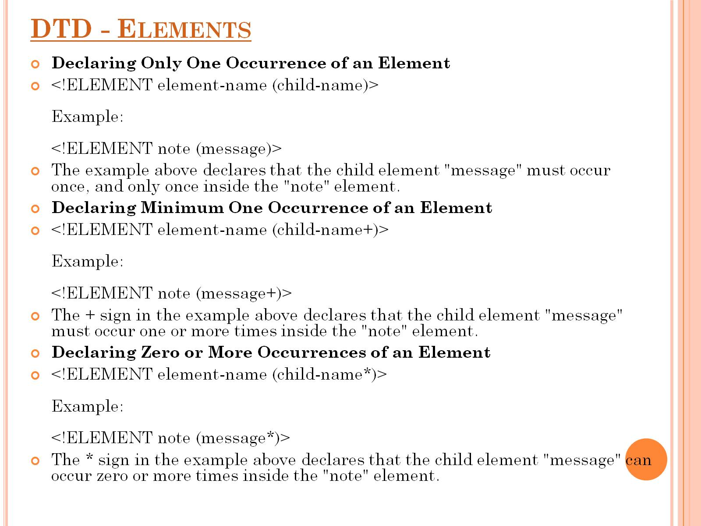
DTD - Elements

Slide 33
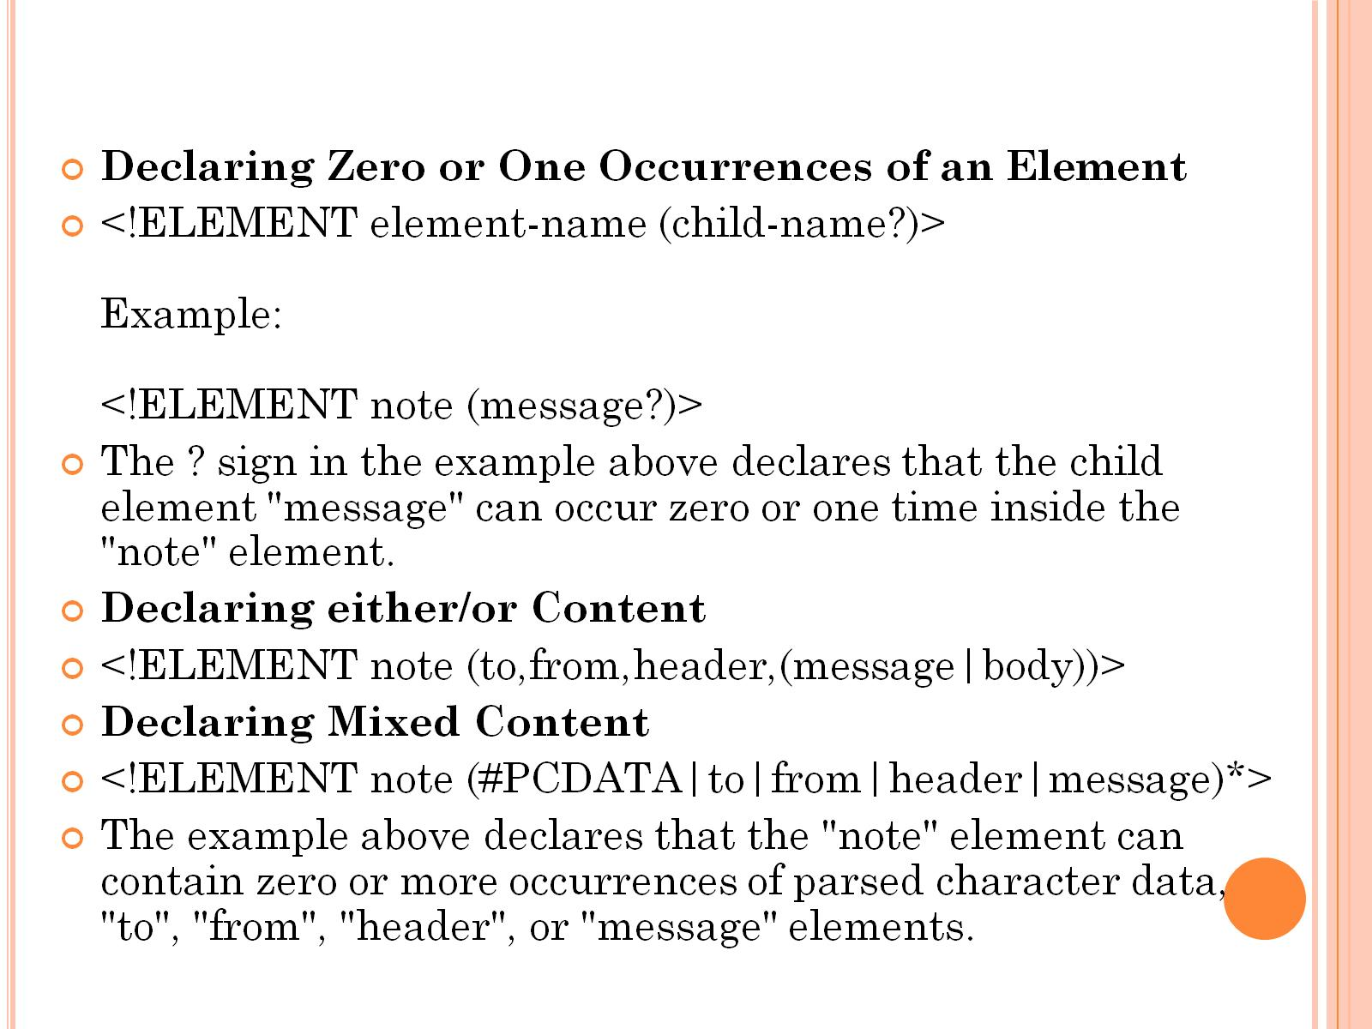

Slide 34
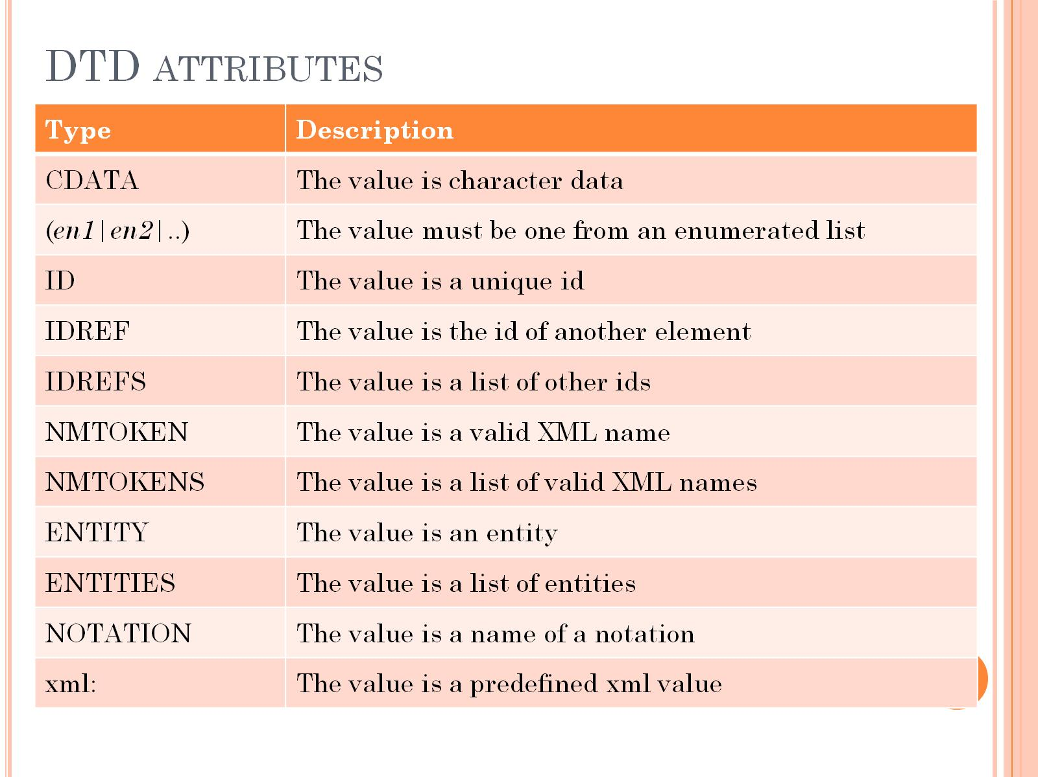
DTD attributes

Slide 35
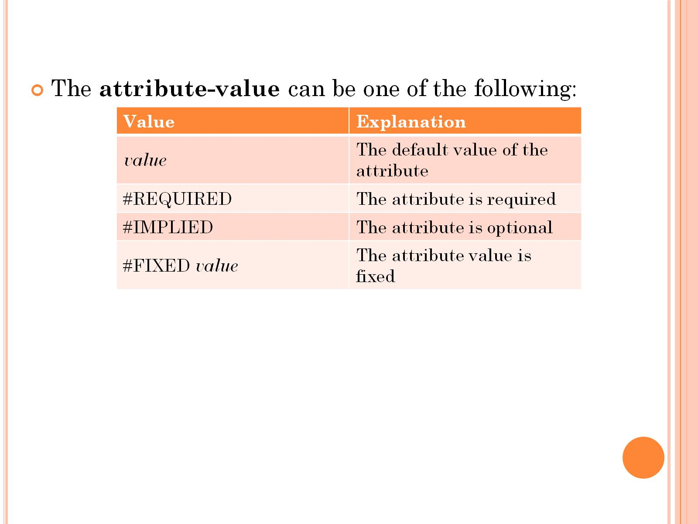

Slide 36
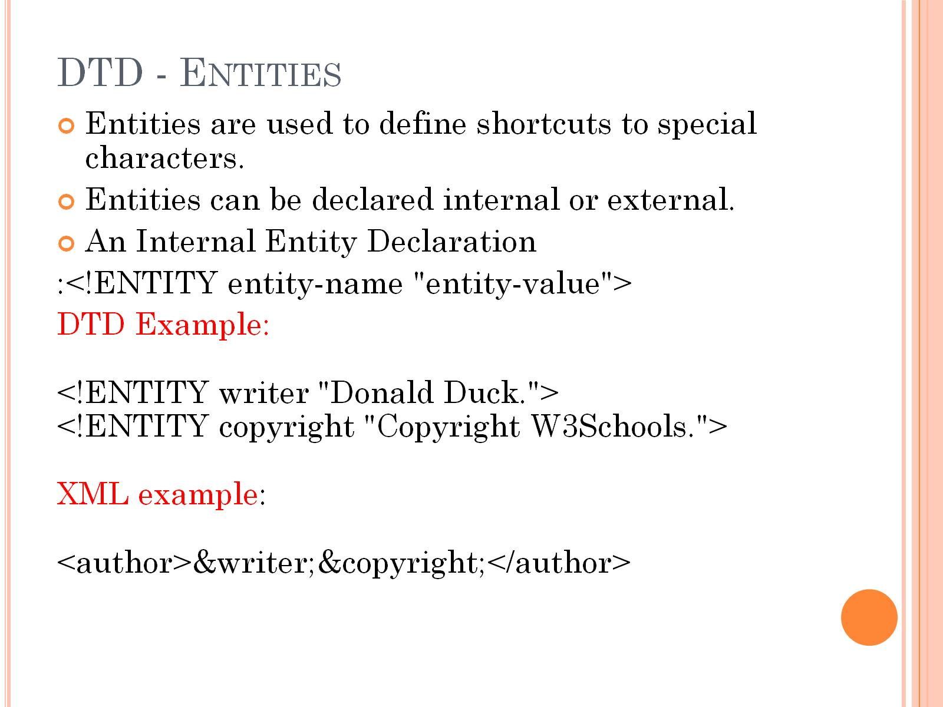
DTD - Entities

Slide 37
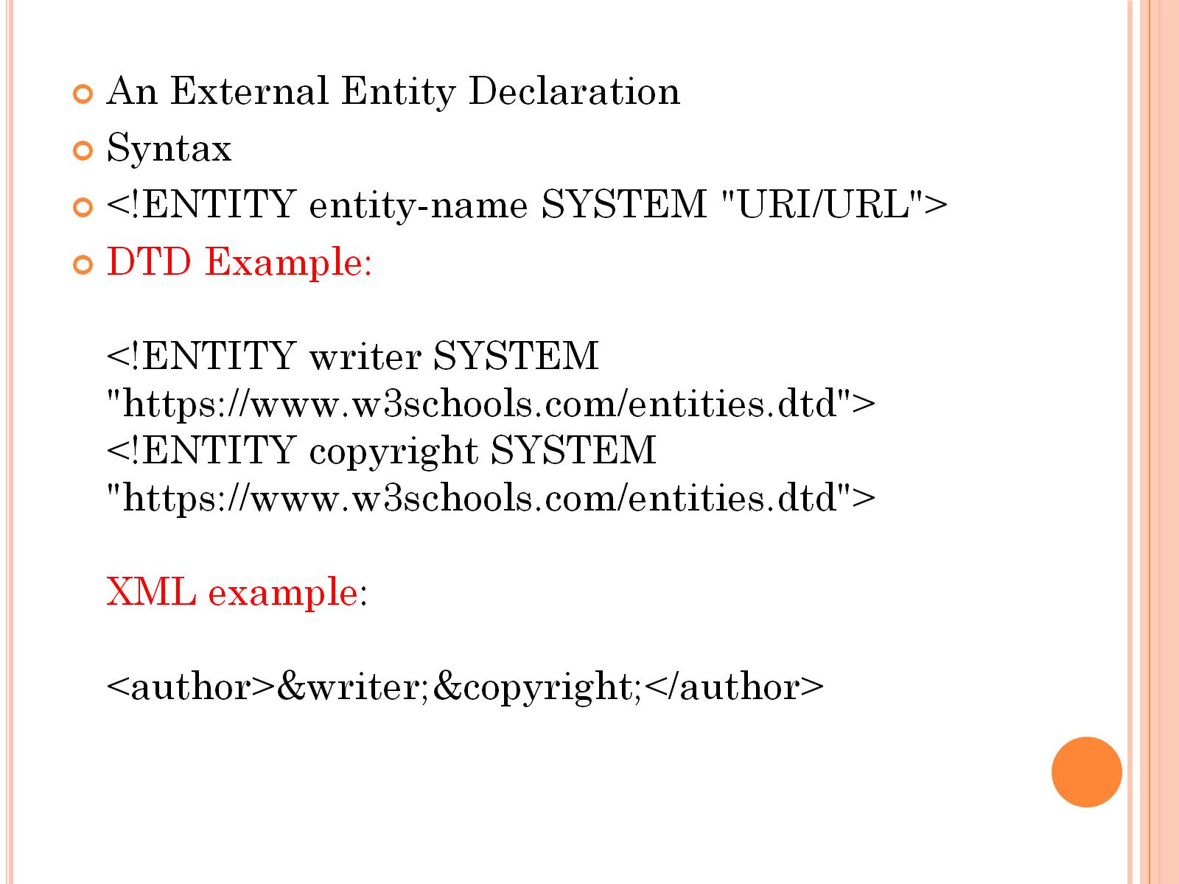

Slide 38
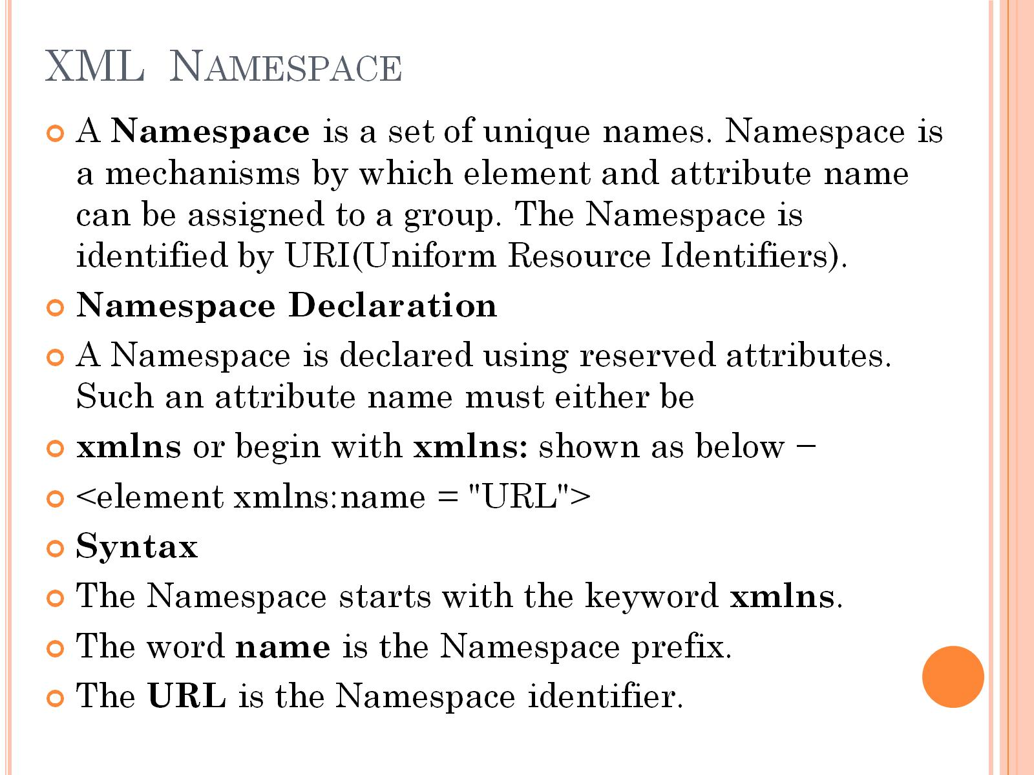
XML Namespace

Slide 39
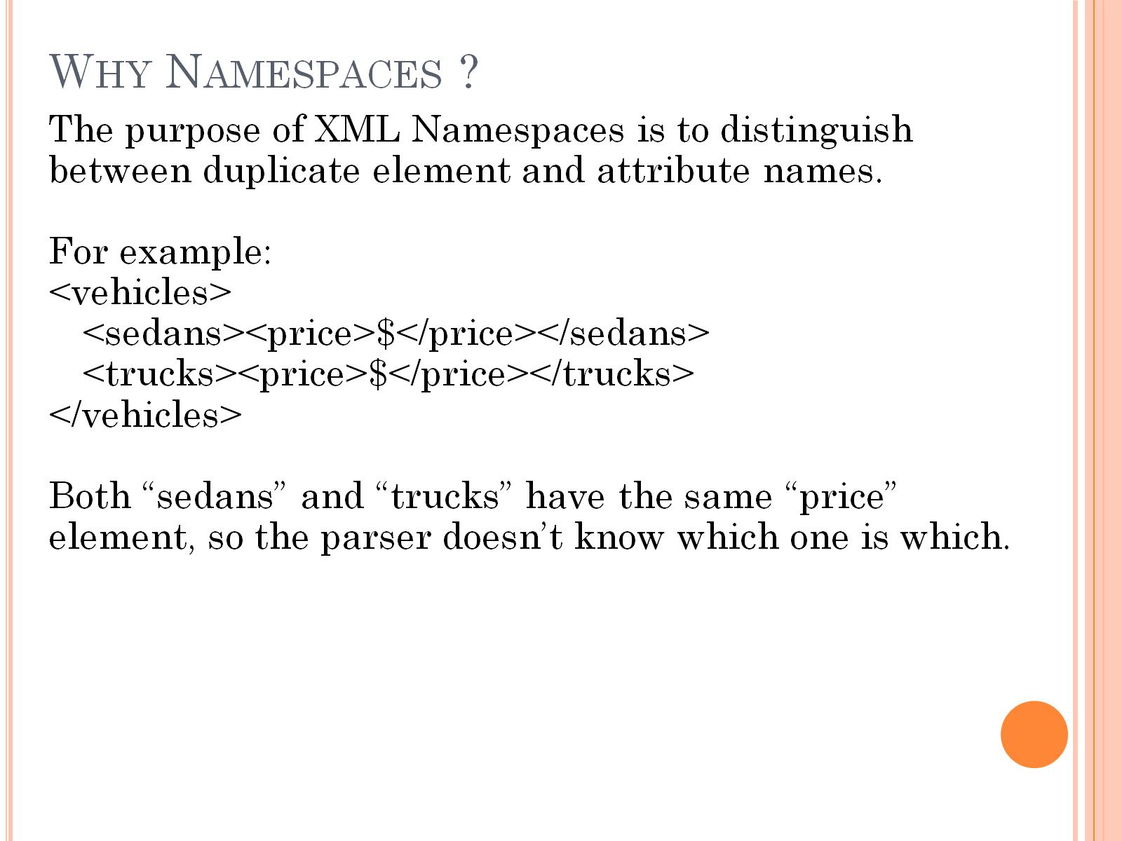
Why Namespaces ?

Slide 40
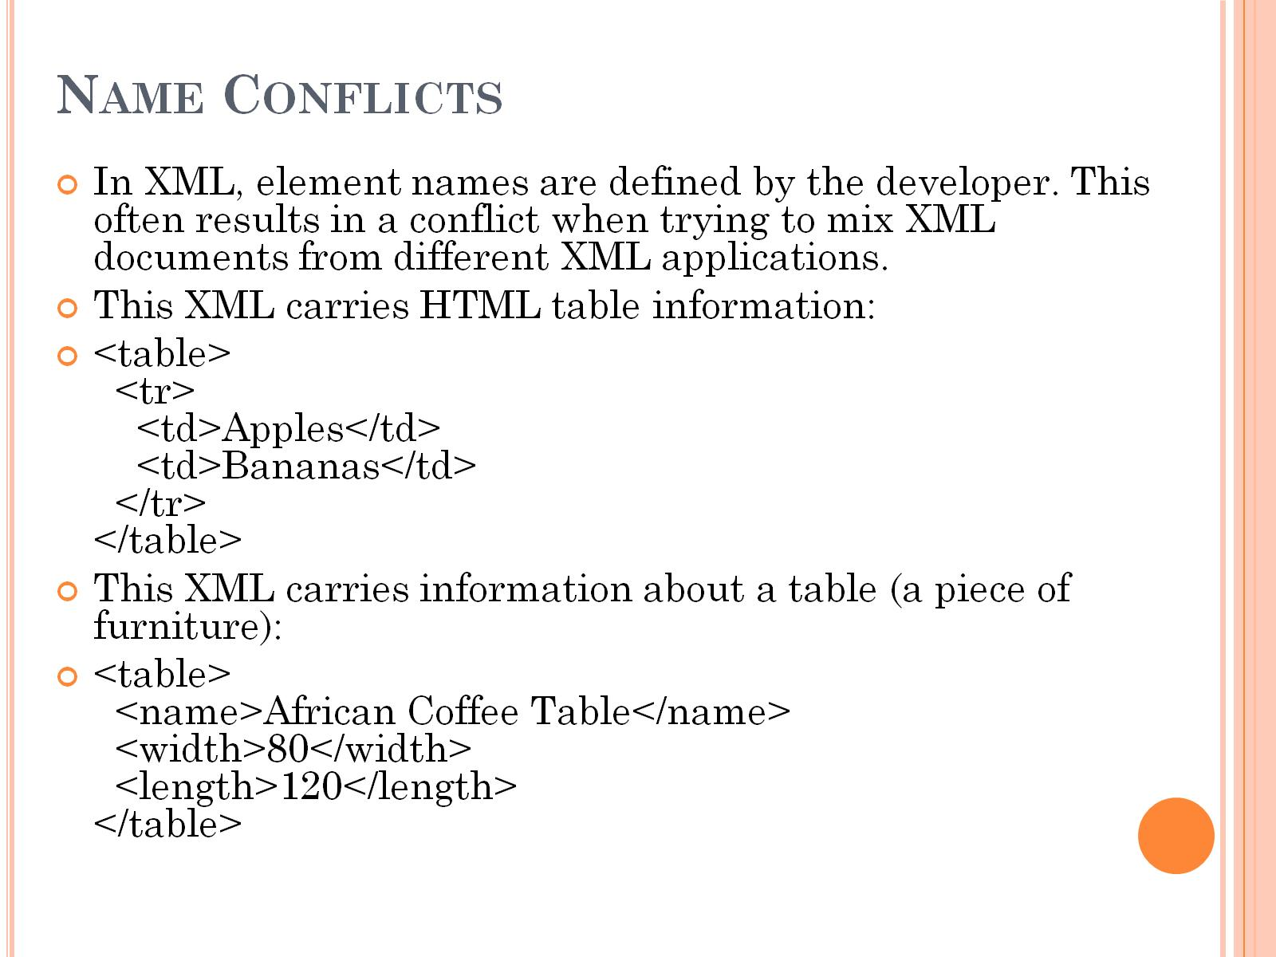
Name Conflicts

Slide 41
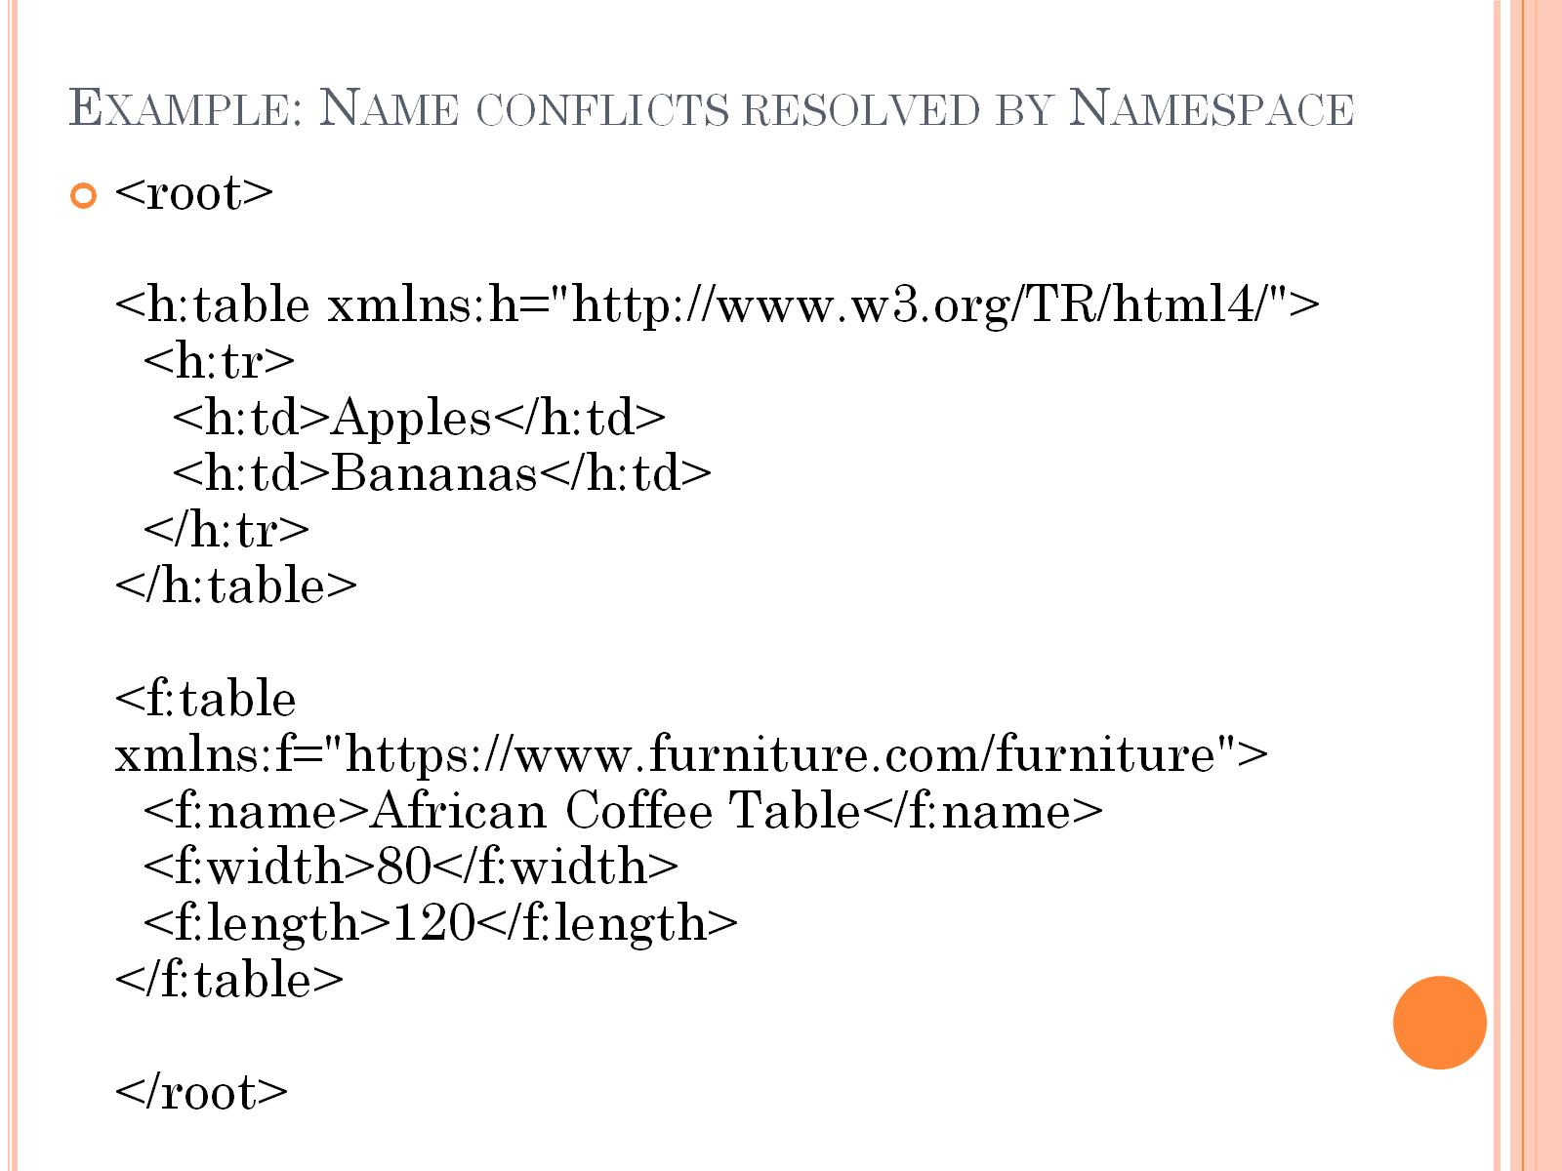
Example: Name conflicts resolved by Namespace

Slide 42
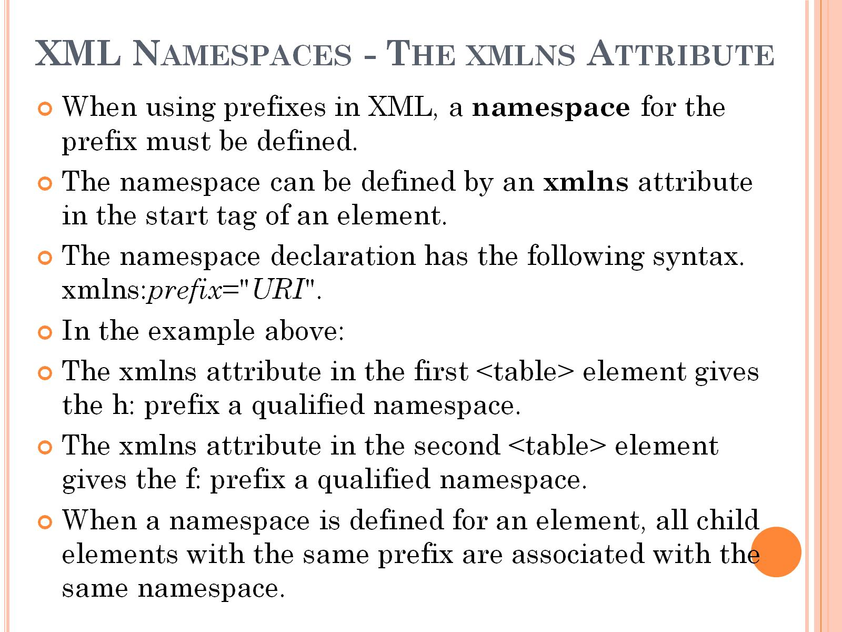
XML Namespaces - The xmlns Attribute

Slide 43
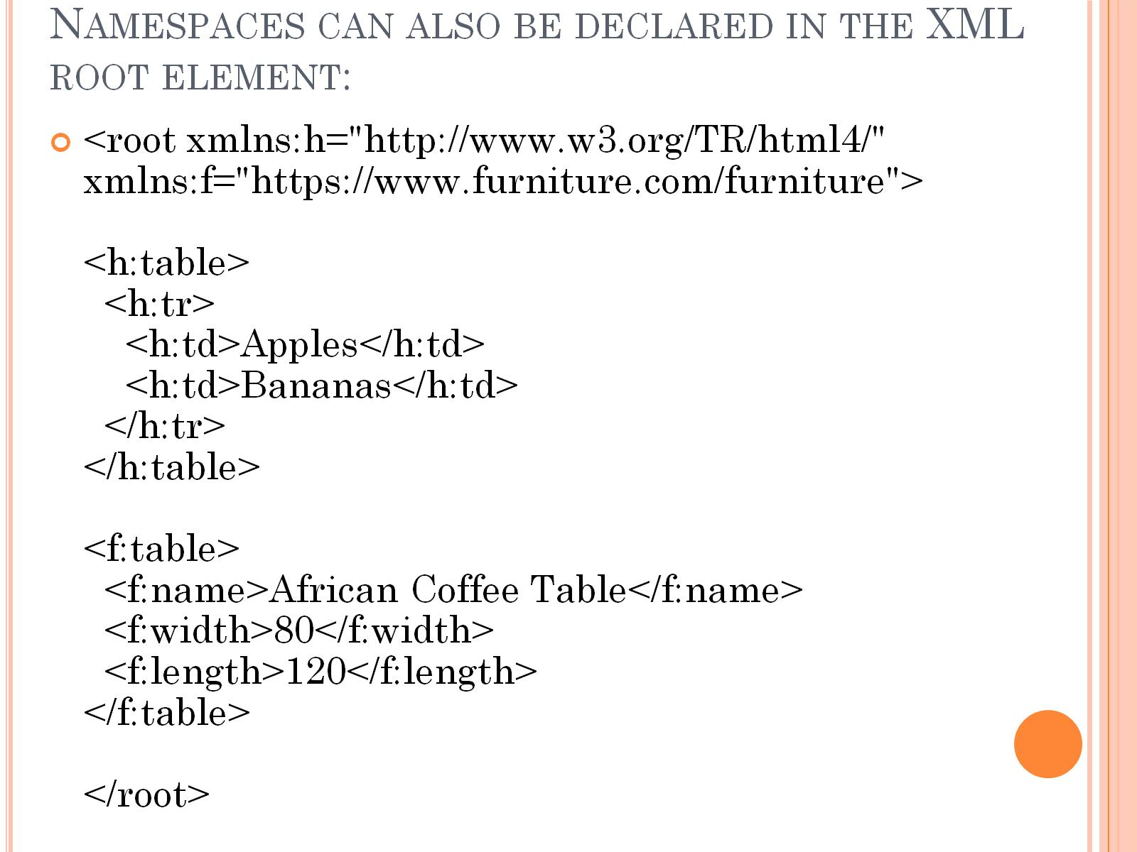
Namespaces can also be declared in the XML root element:

Slide 44
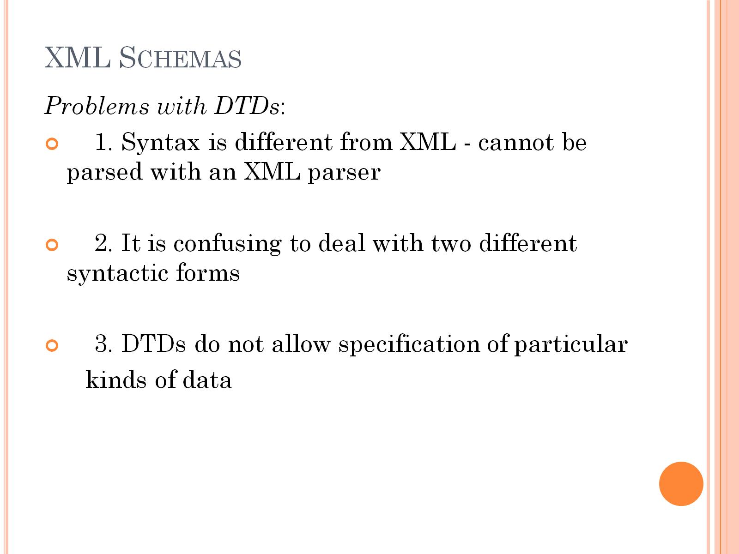
XML Schemas

Slide 45
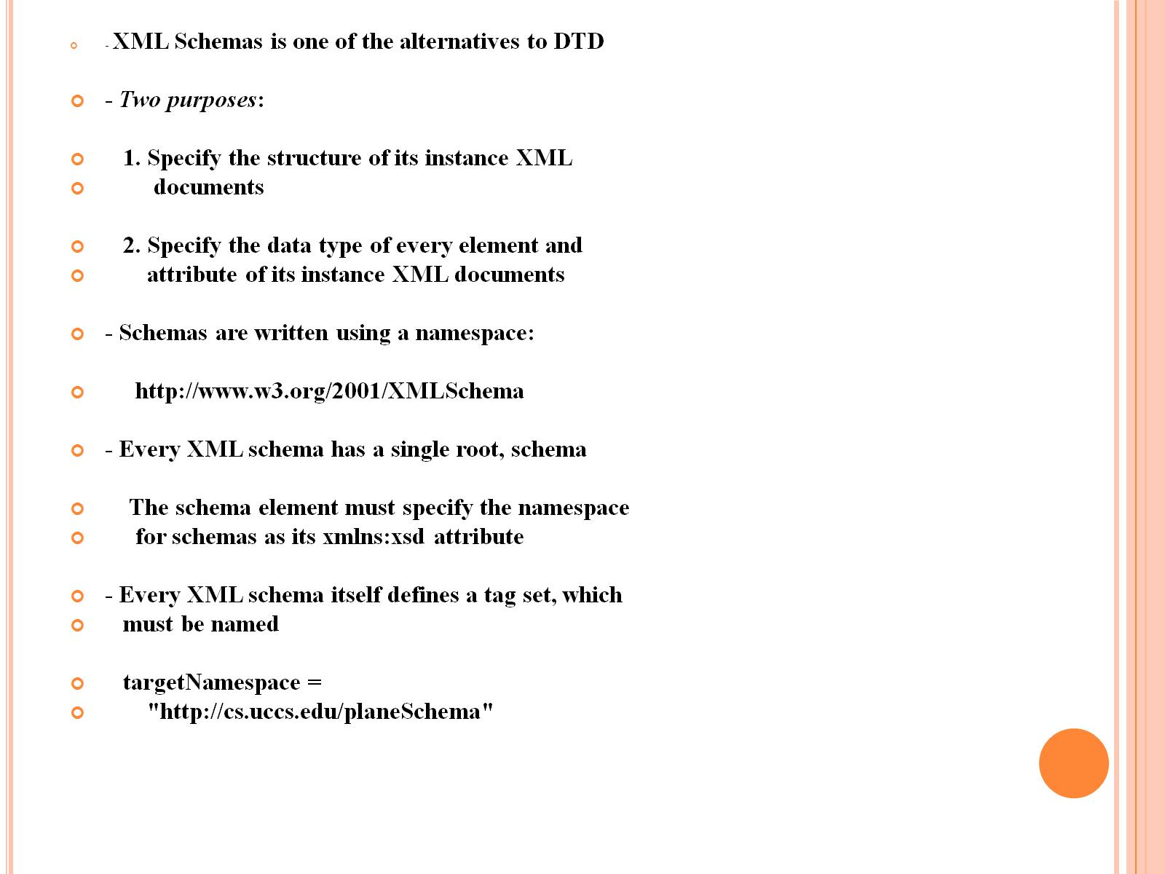

Slide 46
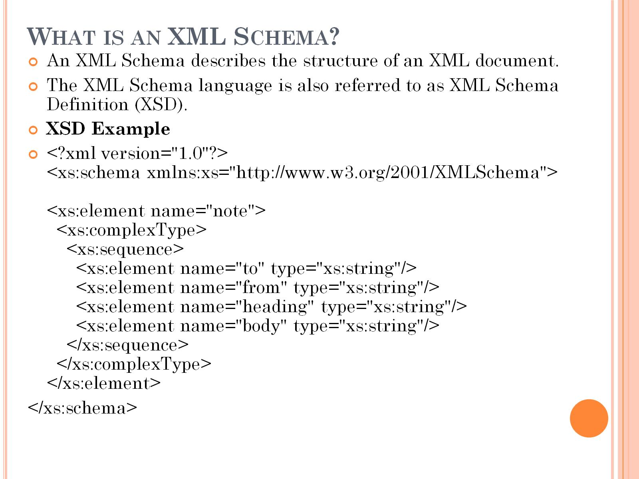
What is an XML Schema?

Slide 47
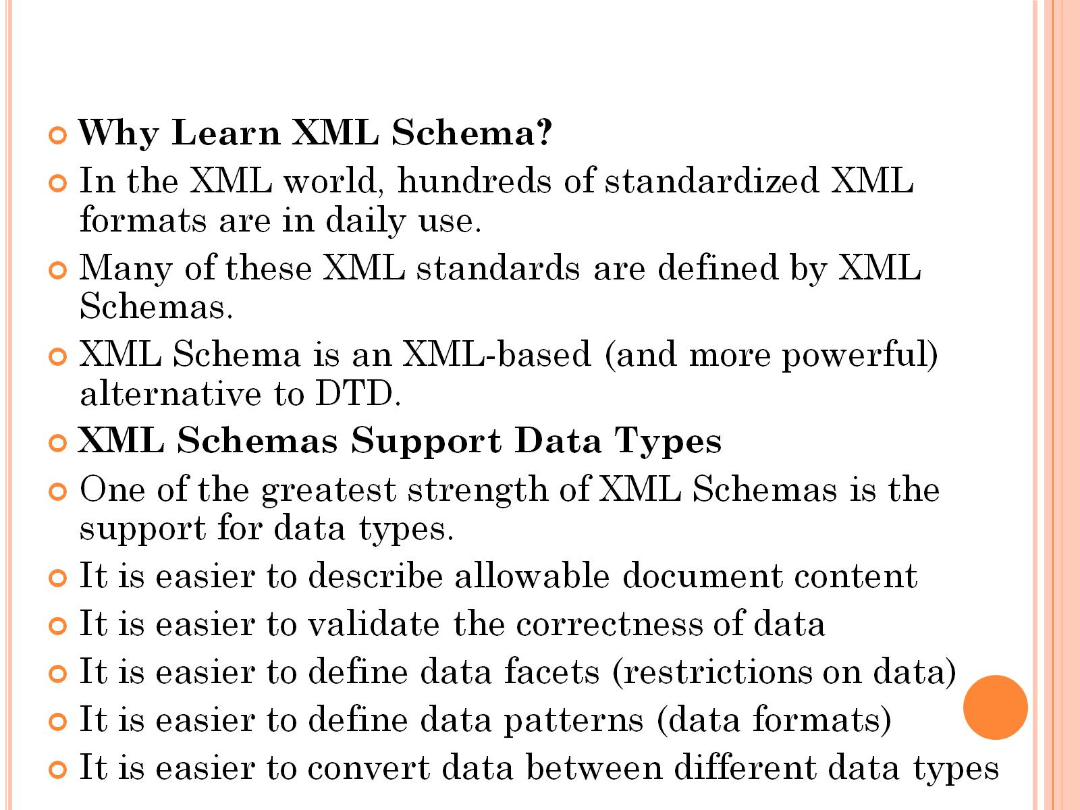

Slide 48
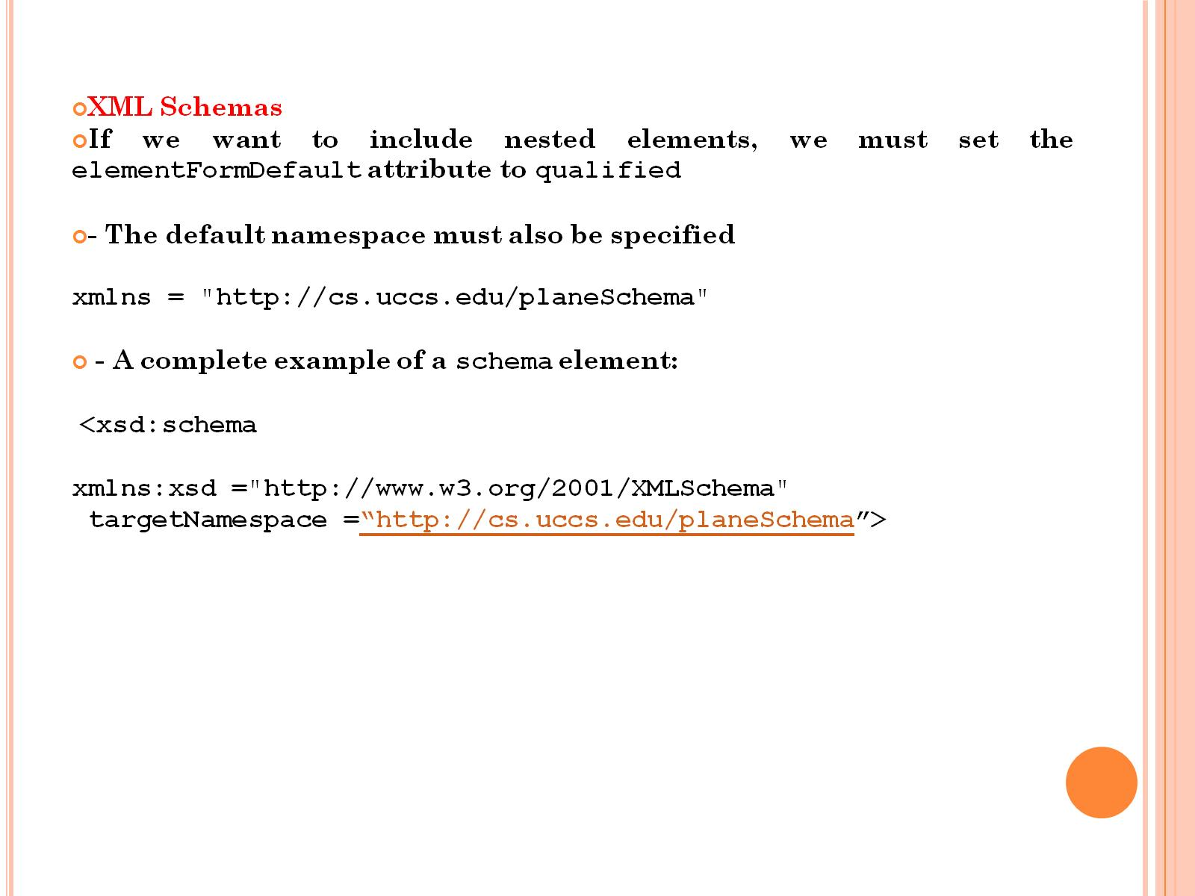

Slide 49
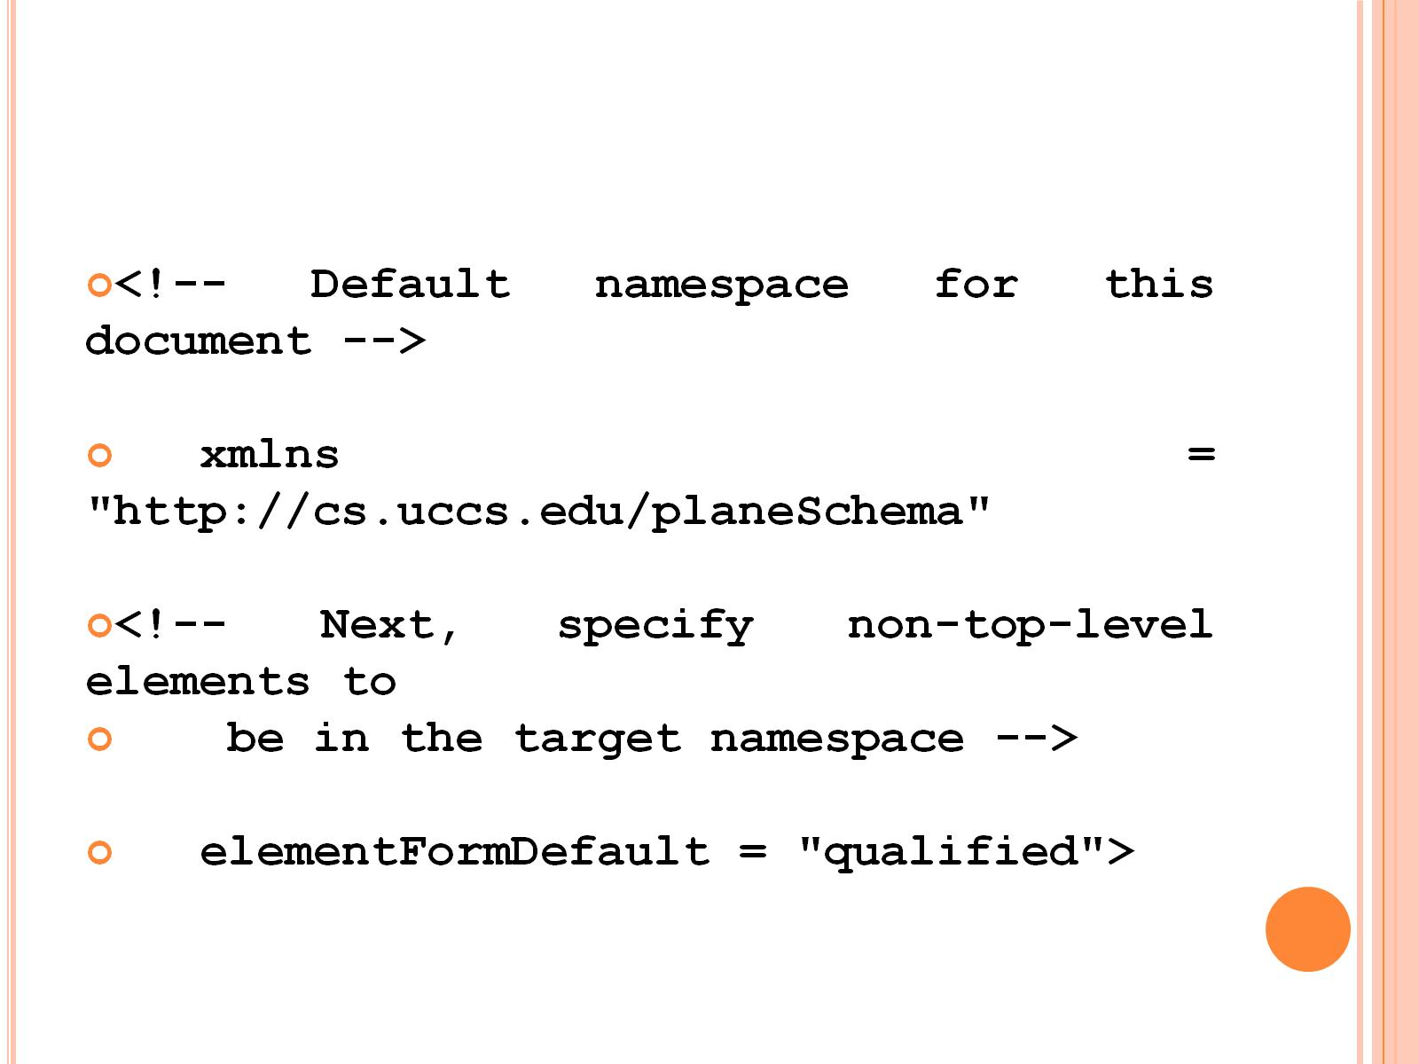

Slide 50
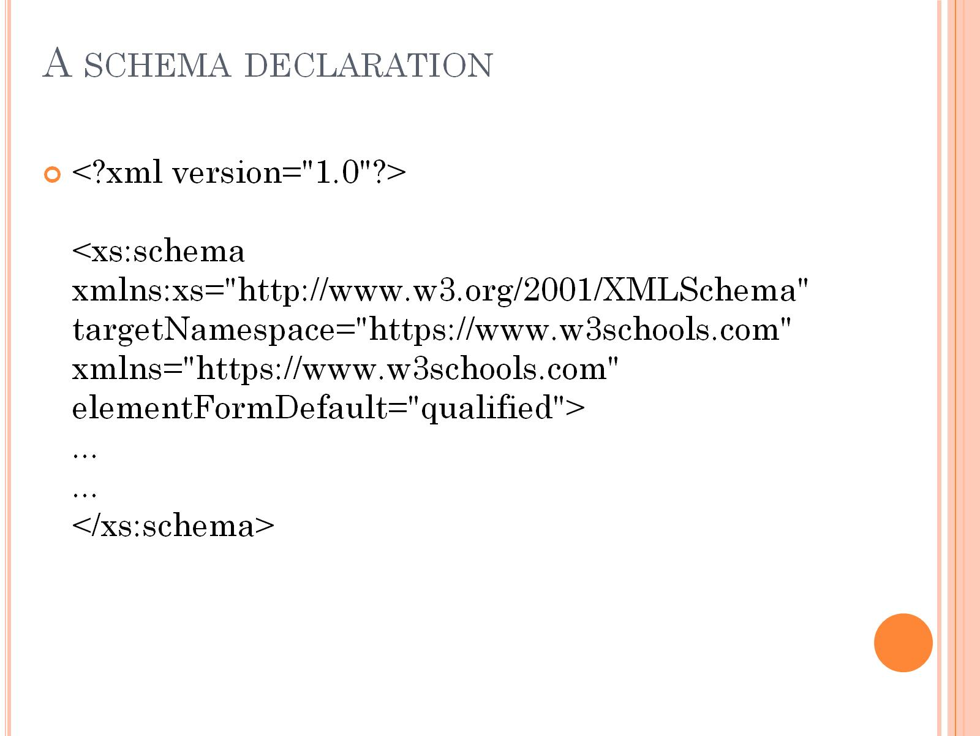
A schema declaration

Slide 51
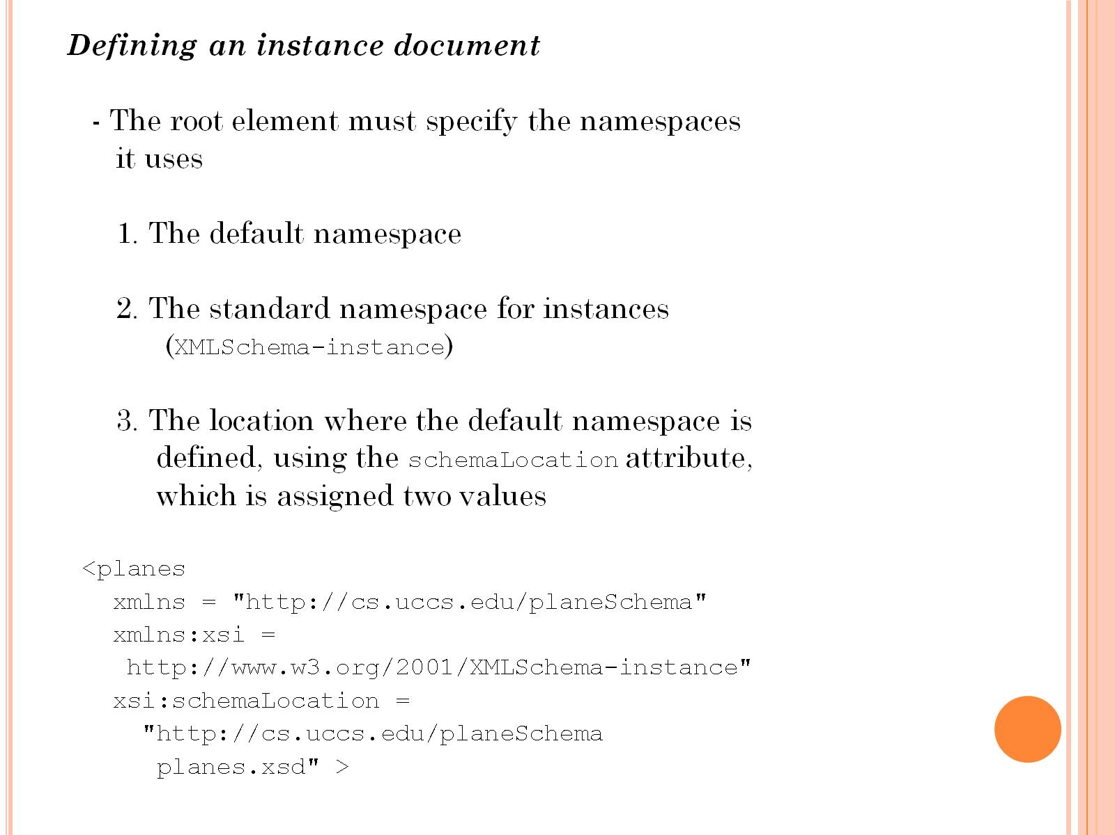

Slide 52


Slide 53

Xml schema

Slide 54


Slide 55


Slide 56


Slide 57

XSD Simple Elements

Slide 58

Example

Slide 59

What is an Attribute?

Slide 60

Default and Fixed Values for Attributes

Slide 61


Slide 62

Example program for xml css

Slide 63

Program for Rule css

Slide 64


Slide 65


Slide 66


Slide 67

XSLT program

Slide 68


Slide 69


Slide 70

Html output

Slide 71


Slide 72


Slide 73


Slide 74

More info about XML Parser?

Slide 75

Parsers

Slide 76

SAX Parser

Slide 77

DOM Parser

Slide 78

DOM Document Object

Slide 79

main features of DOM parsers

Slide 80

main features of DOM parsers (cont.)

Slide 81

SAX parsers

Slide 82

SAX parsers (cont.)

Slide 83

SAX parsers (cont.)

